Slide 1
ODOT Region 4 2016 Chip Seals
High Volume, Contract
Aron Sturko
The Dalles Construction Office

Slide 2
Two High Volume Highway Sections
OR126: Redmond to Sisters
~Pre-Coated Hot Chip
US97: Biggs to MP 7.0
~Emulsified Chip
Notes:
Both of these sections had an existing dense graded asphalt mix. District maintenance preference was to utilize an emulsified chip seal on the US97 section primarily because it is more forgiving and has a high rate of success. Traffic volumes on UR126 were to high to consider anything but a Hot Oil chip seal application.

Slide 3
OR126
16.7 Roadway Miles
Placed Mid-August
Oil was AC-15P
3/8” – No. 4 Coated
Some local bike concern about shoulder surface
Delays kept to under 30 minutes. Traffic control was critical
Notes:
Items to note on this section:
The chip was applied in Mid-August with very favorable weather (low 60, high 95). Did have to shut down twice for a couple of hours in the afternoon heat because we could not cool the oil enough to open to traffic. Application rates averaged 18 lb/sy of rock and 0.38 gal/sy of oil.

Slide 4
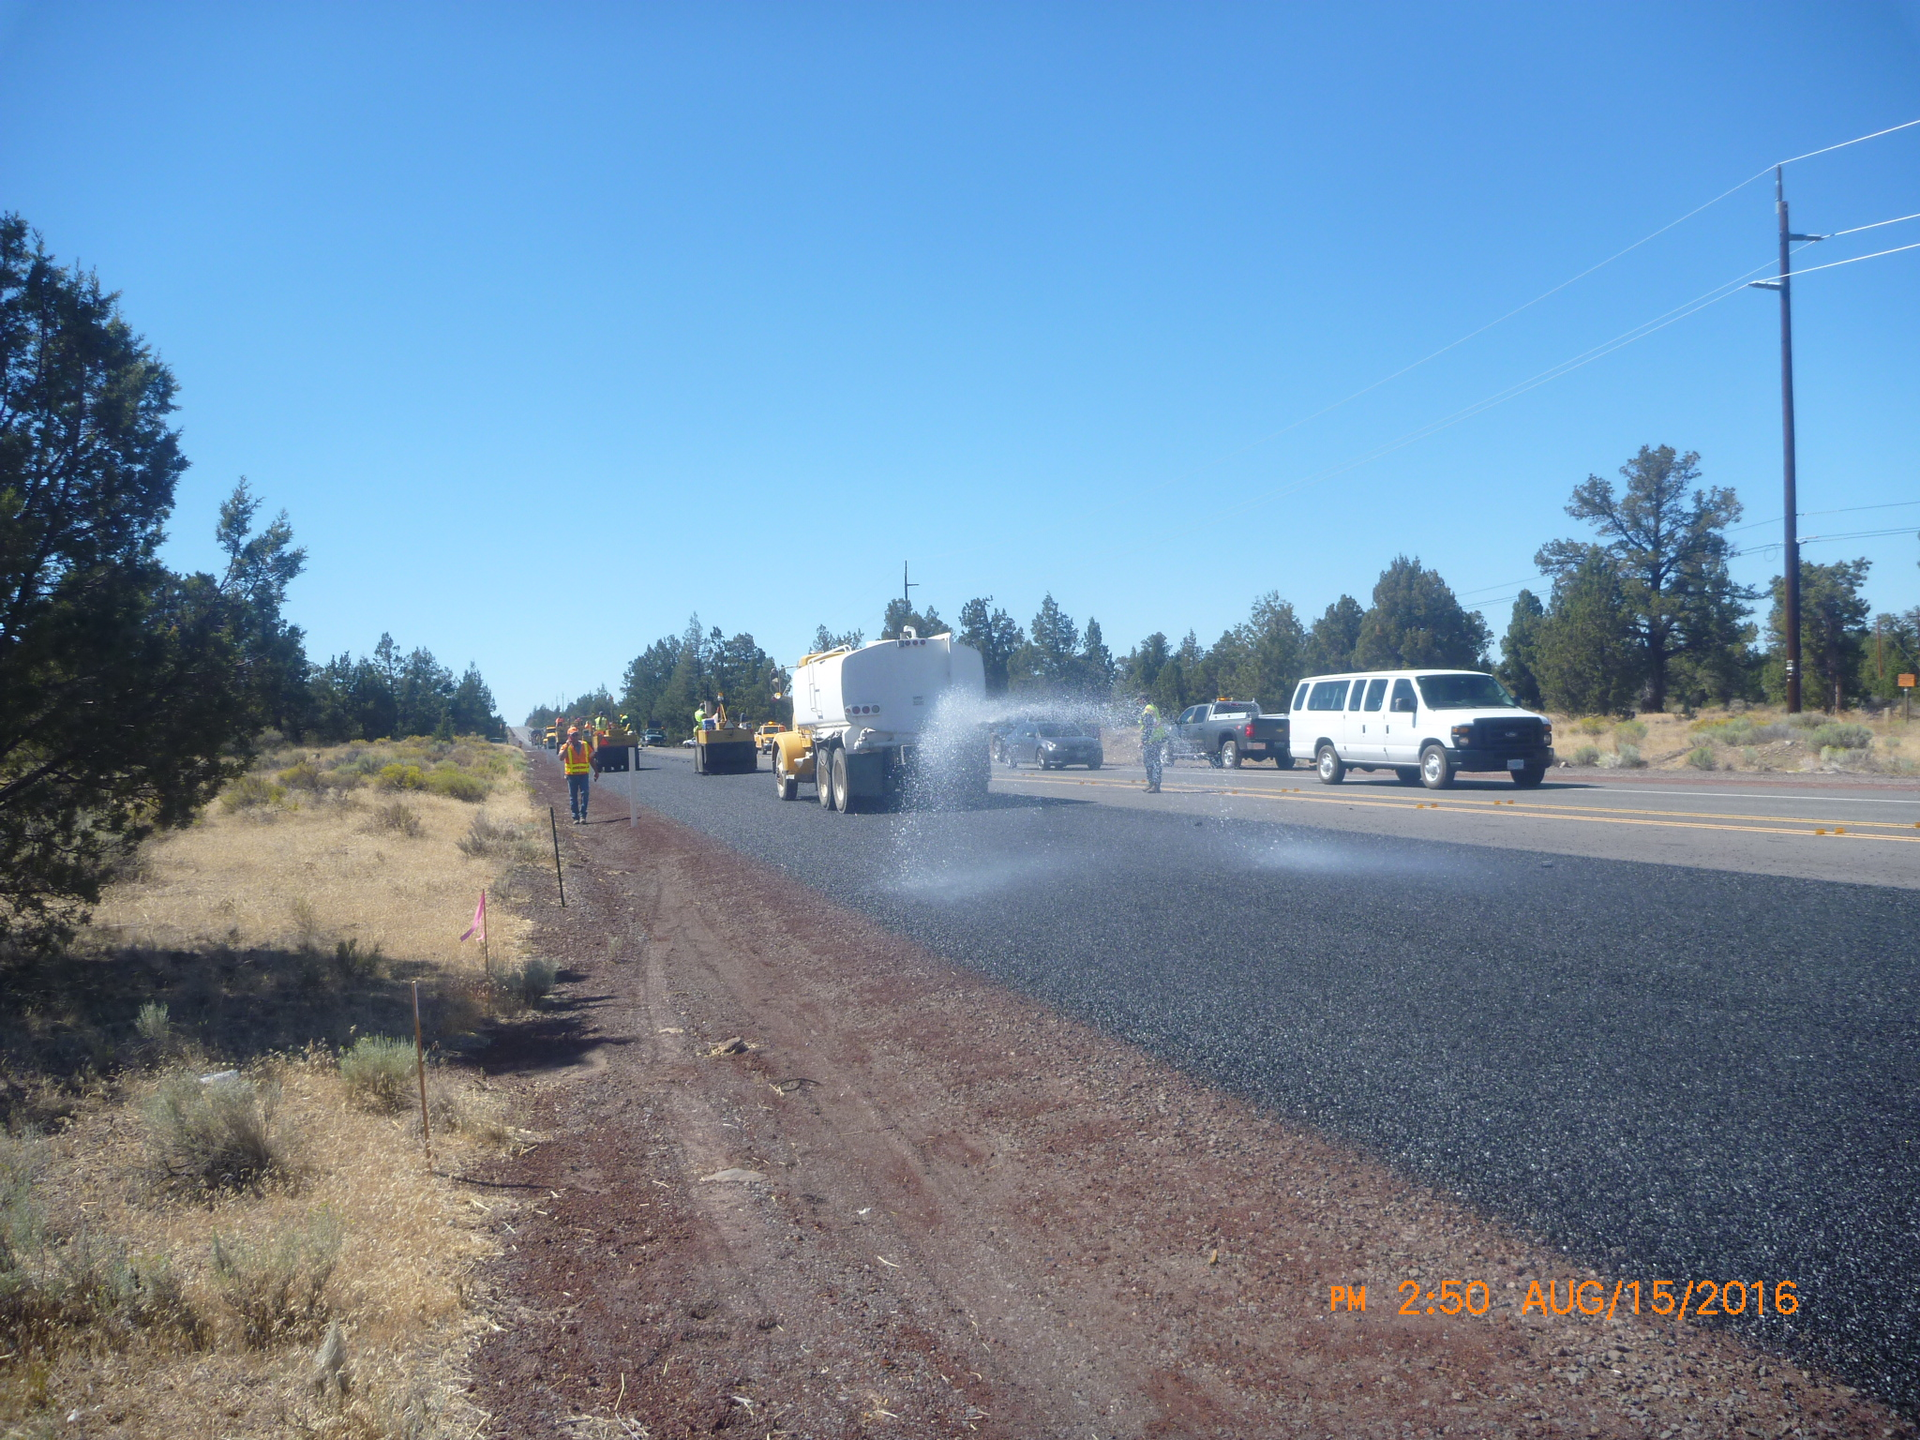

Slide 5
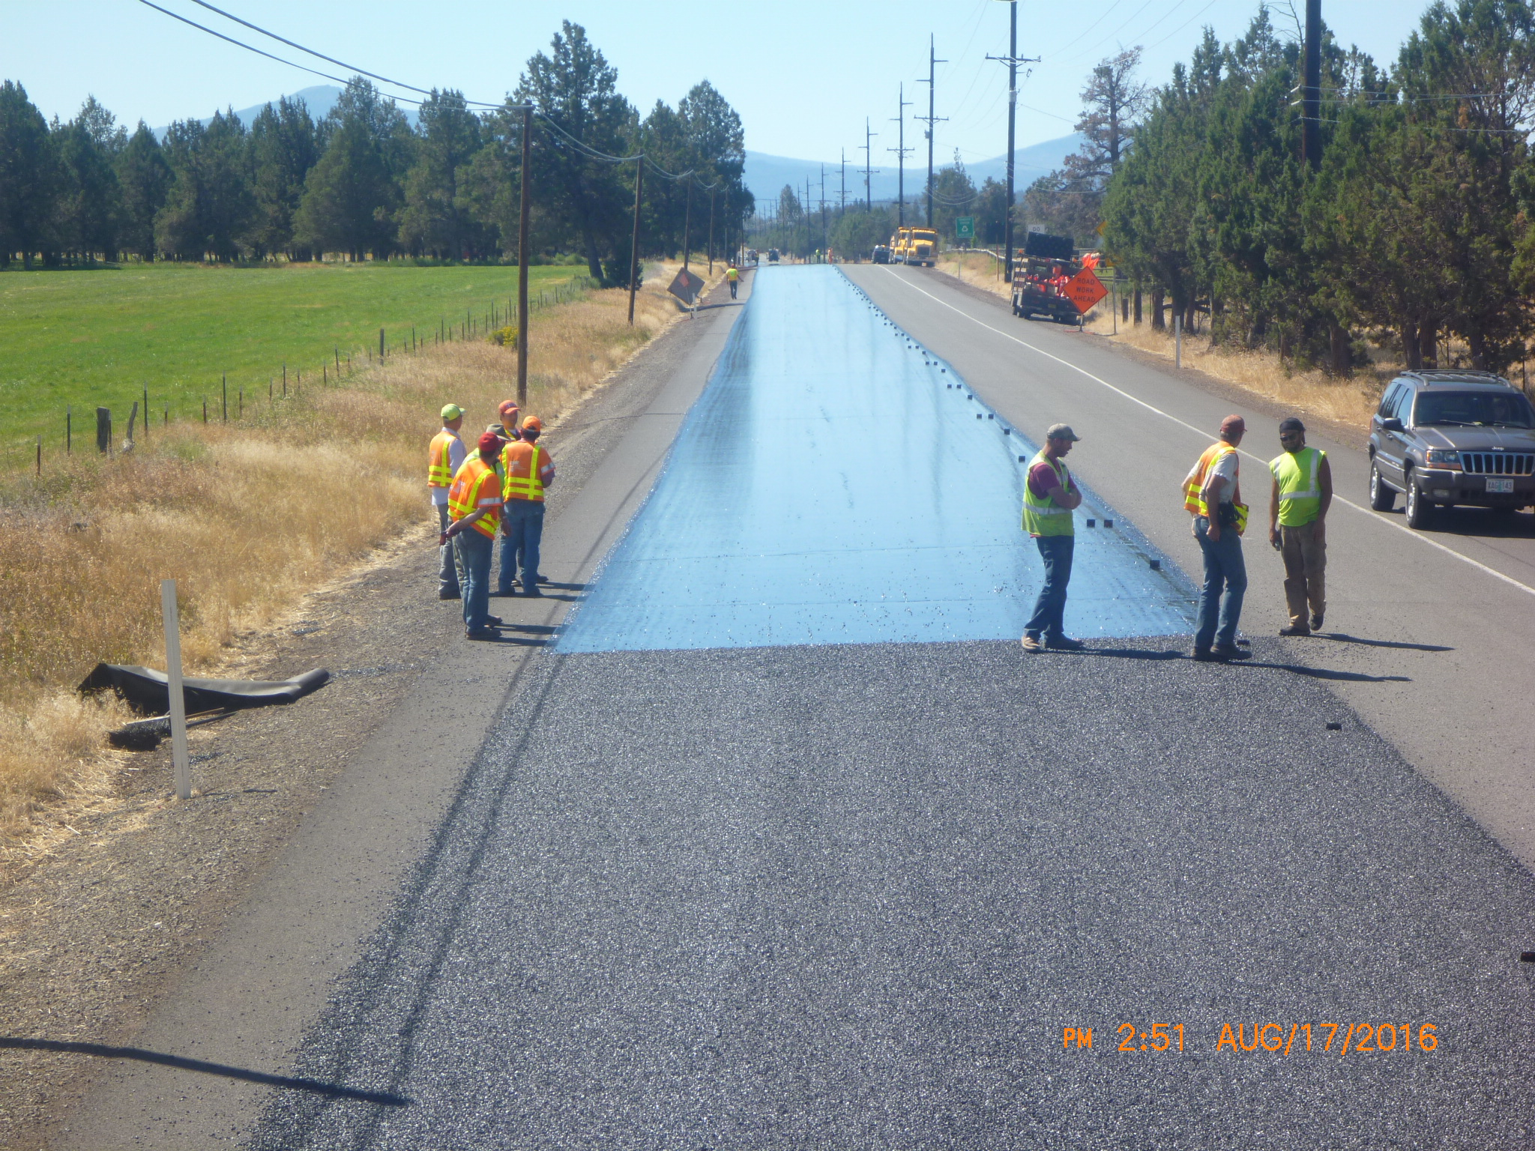

Slide 6
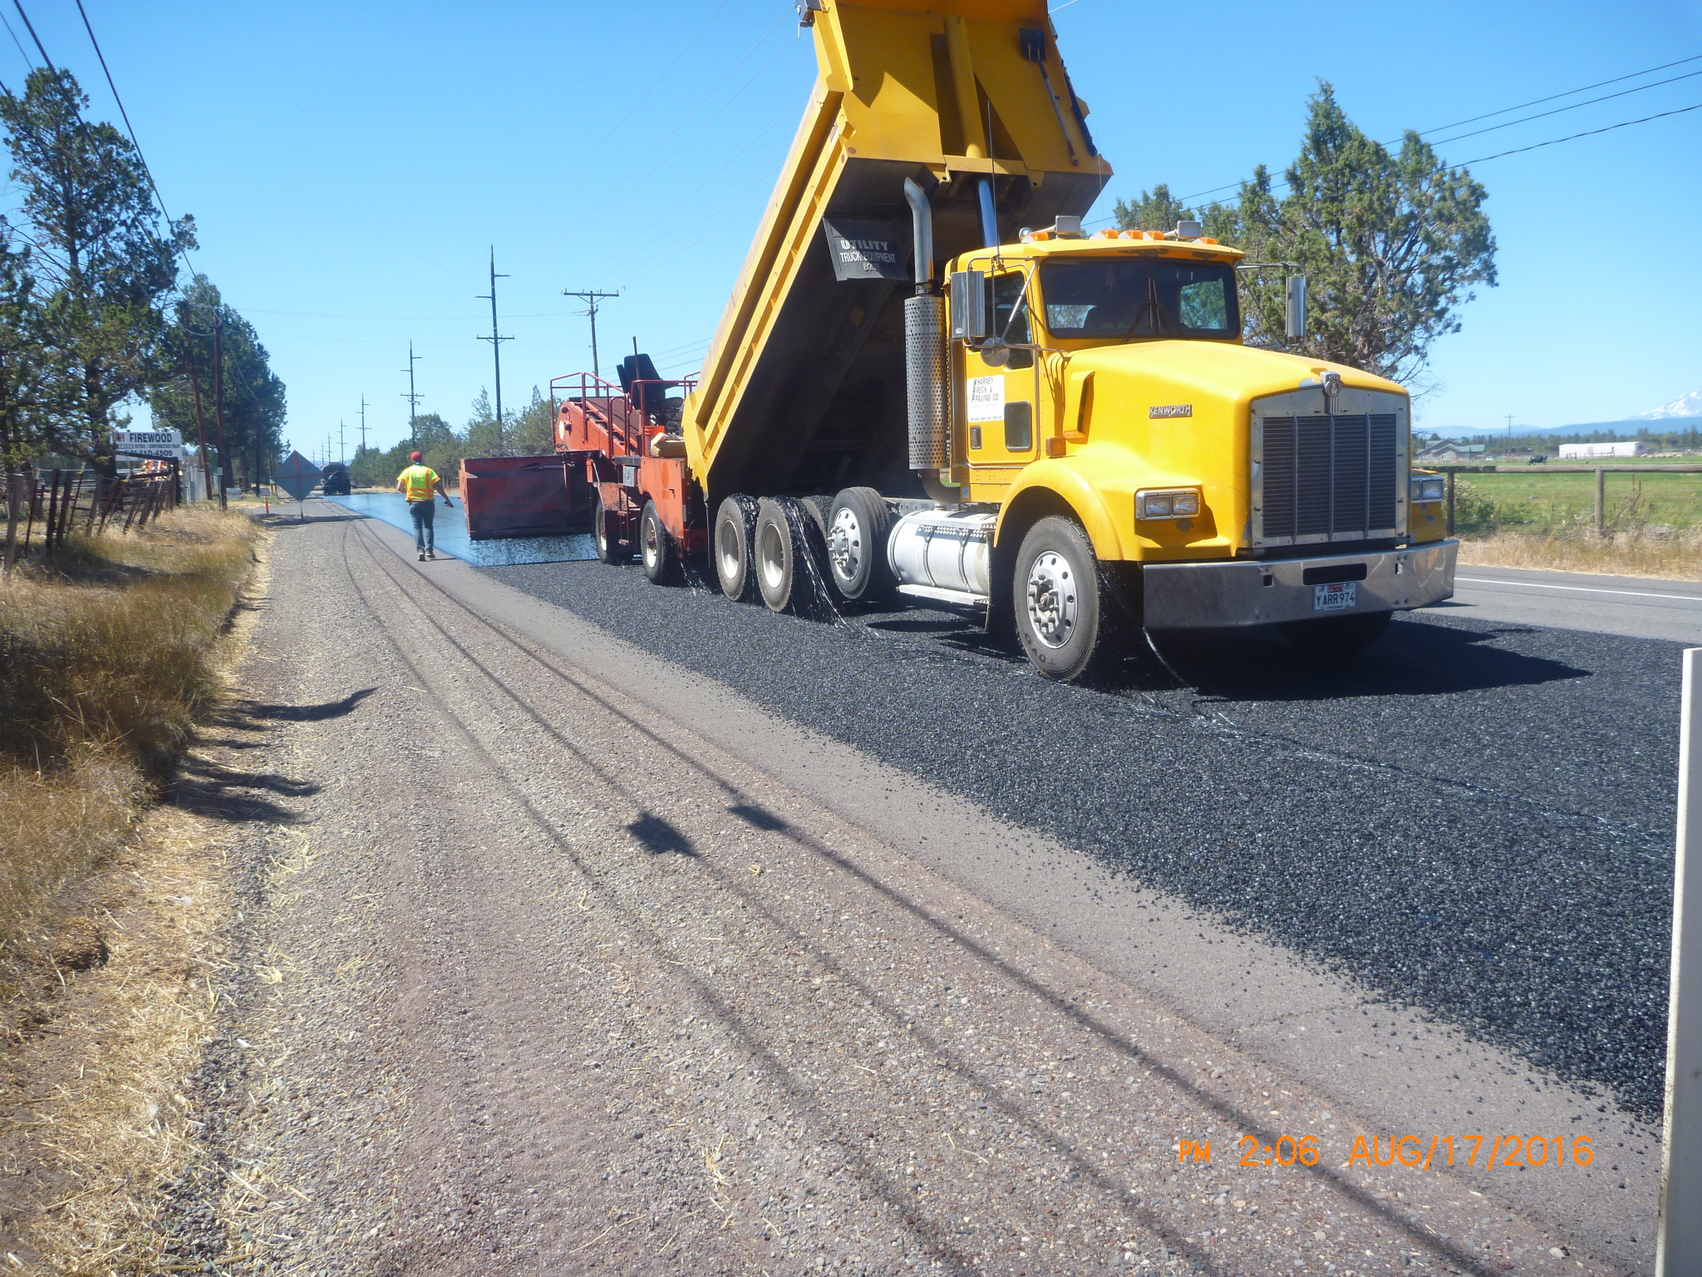

Slide 7
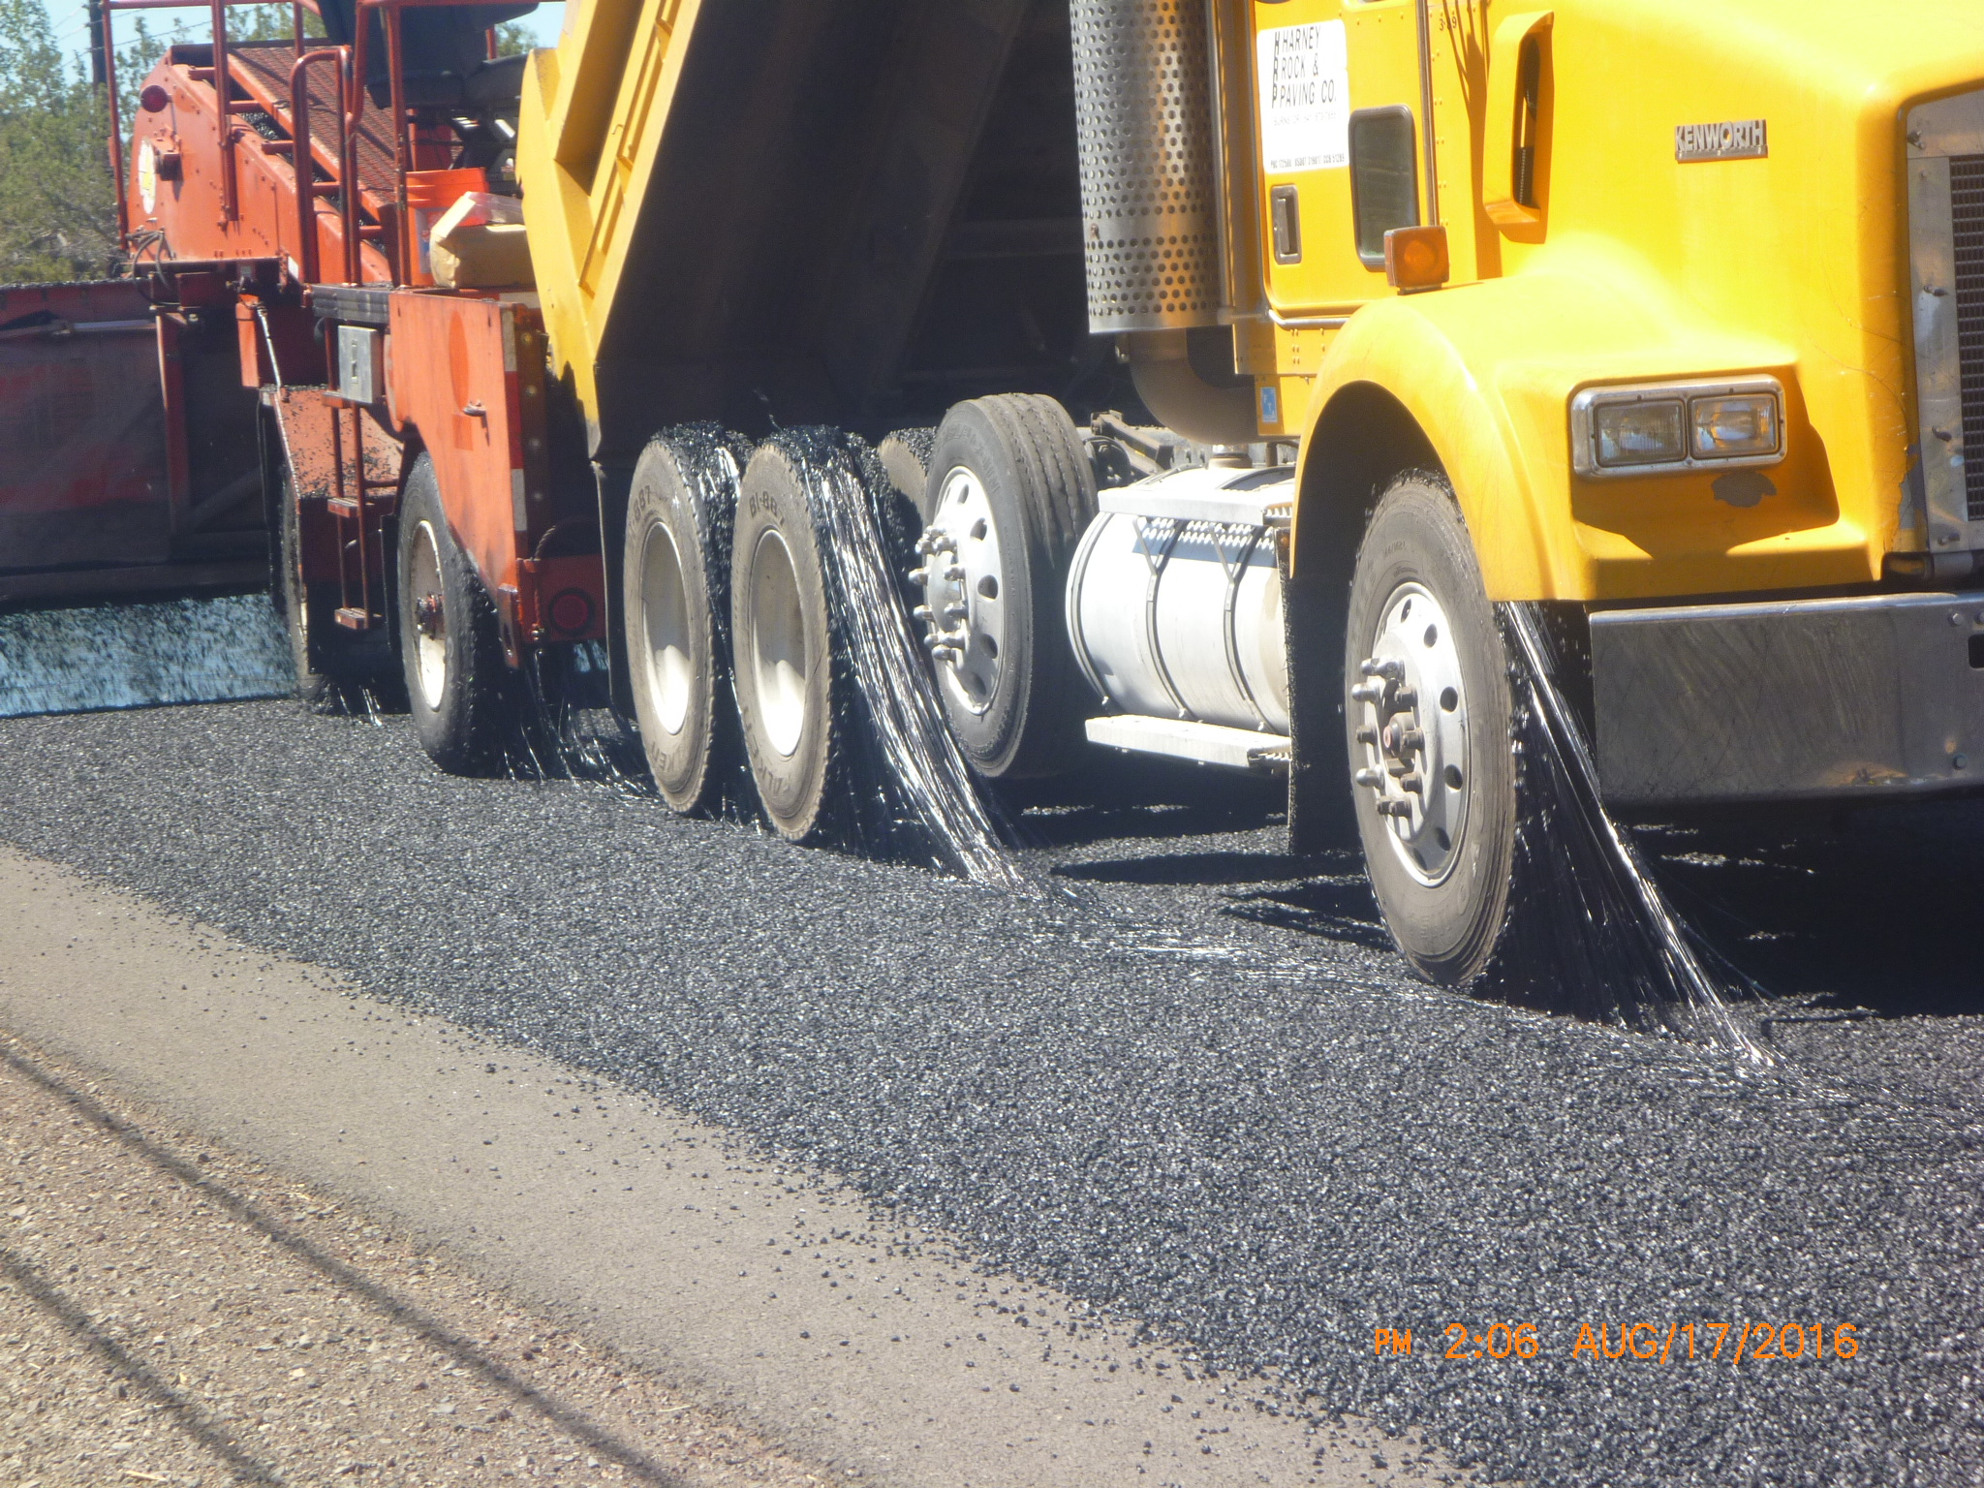

Slide 8
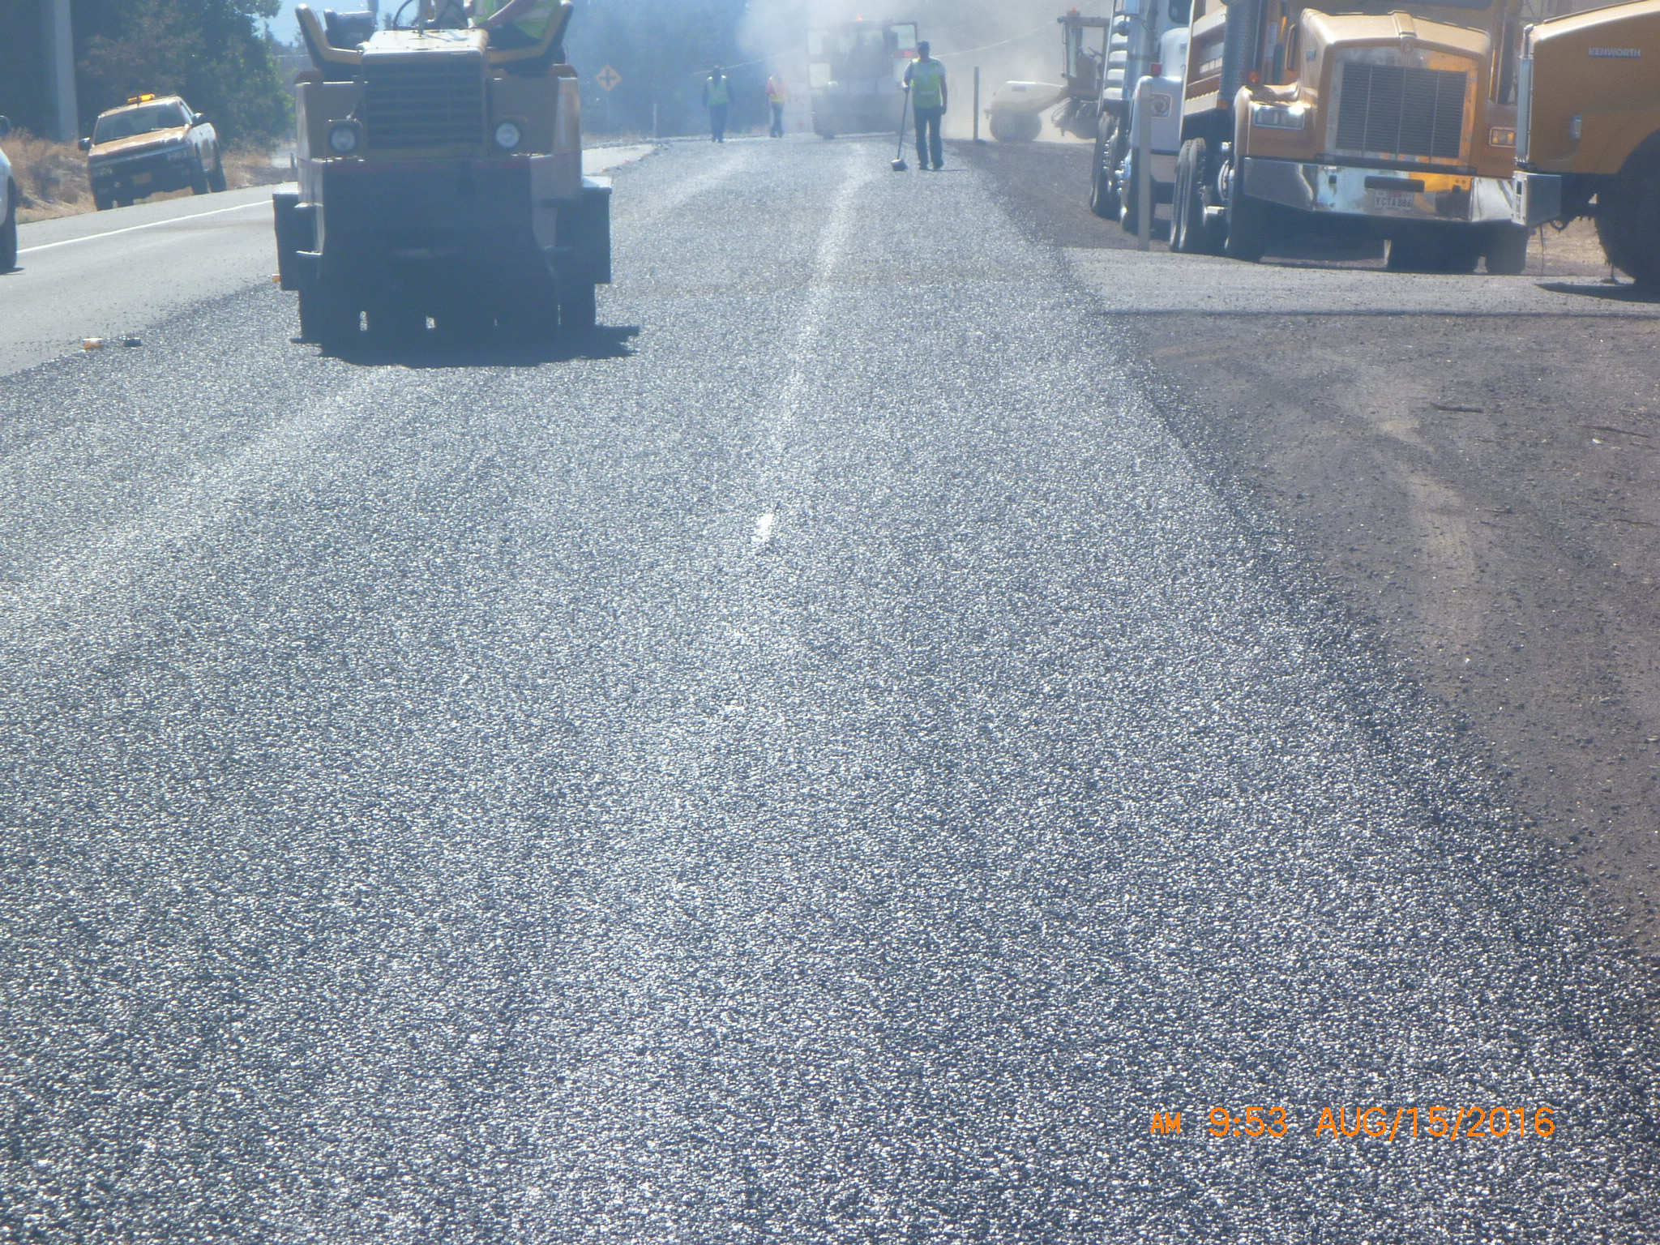

Slide 9
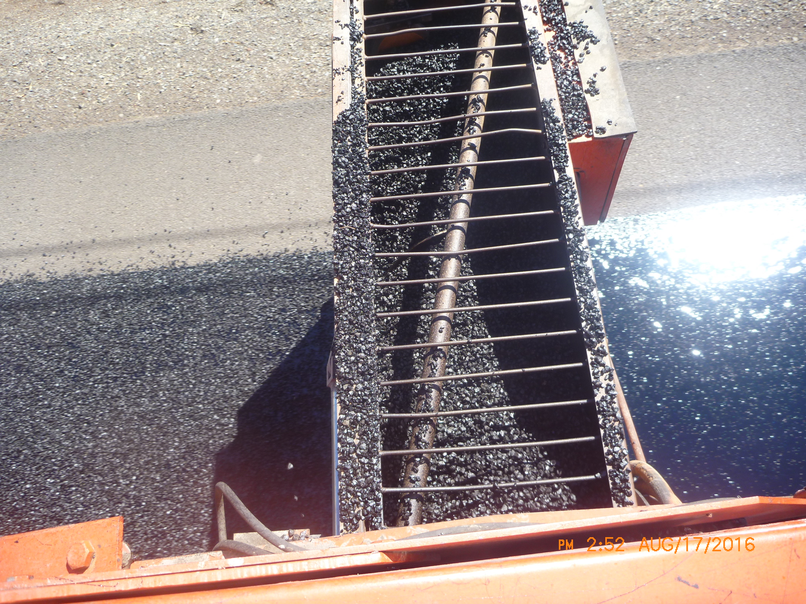

Slide 10
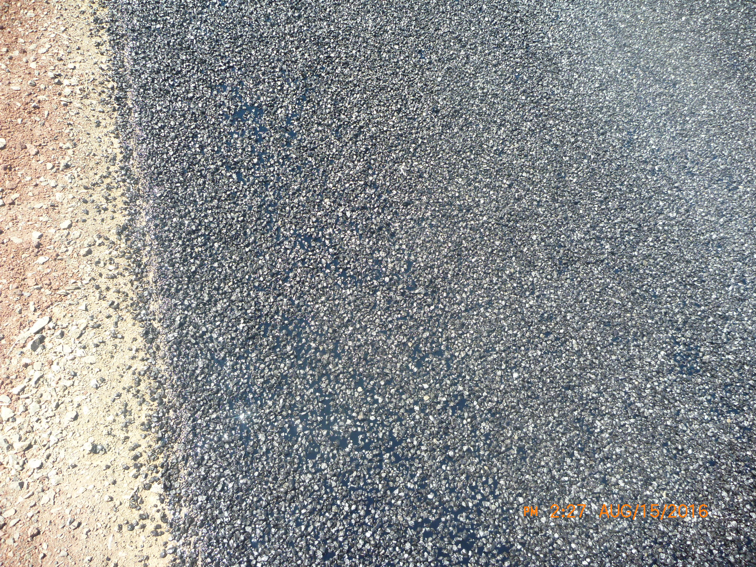

Slide 11
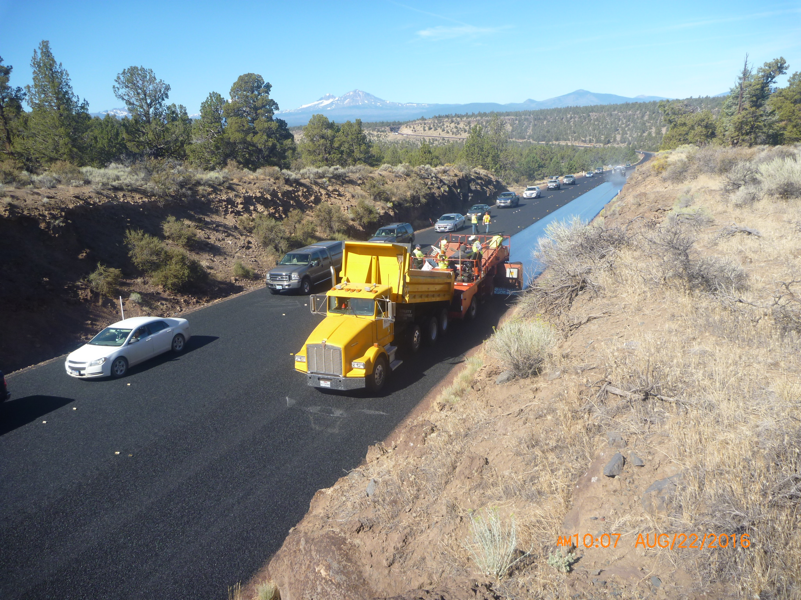

Slide 12
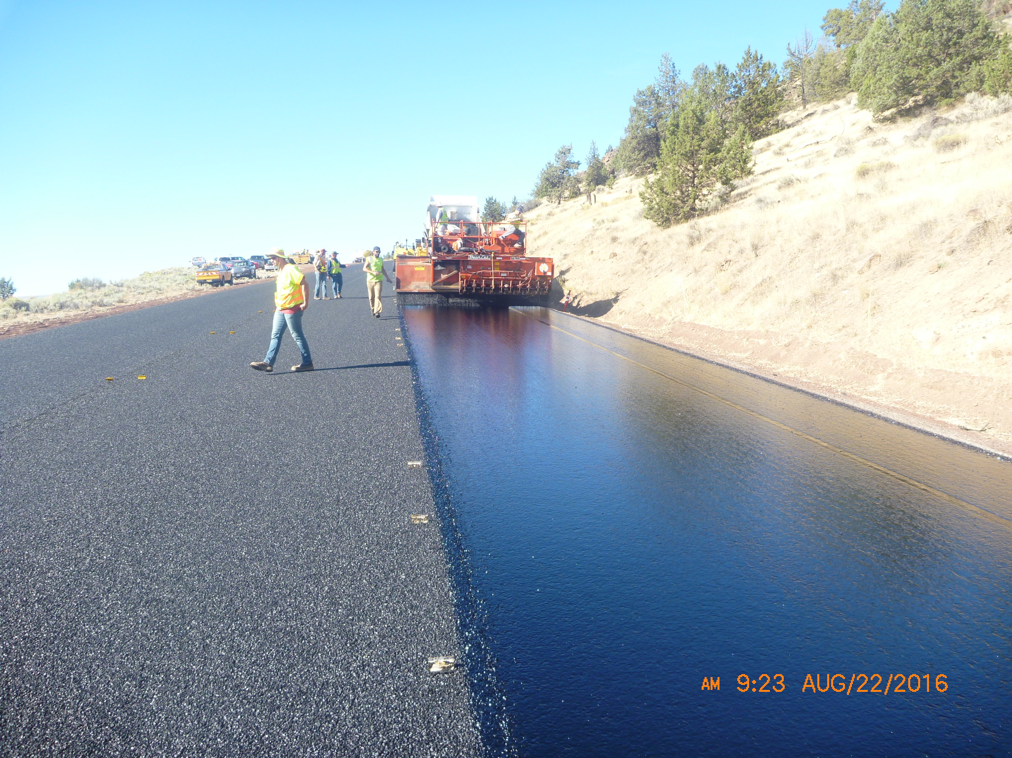

Slide 13
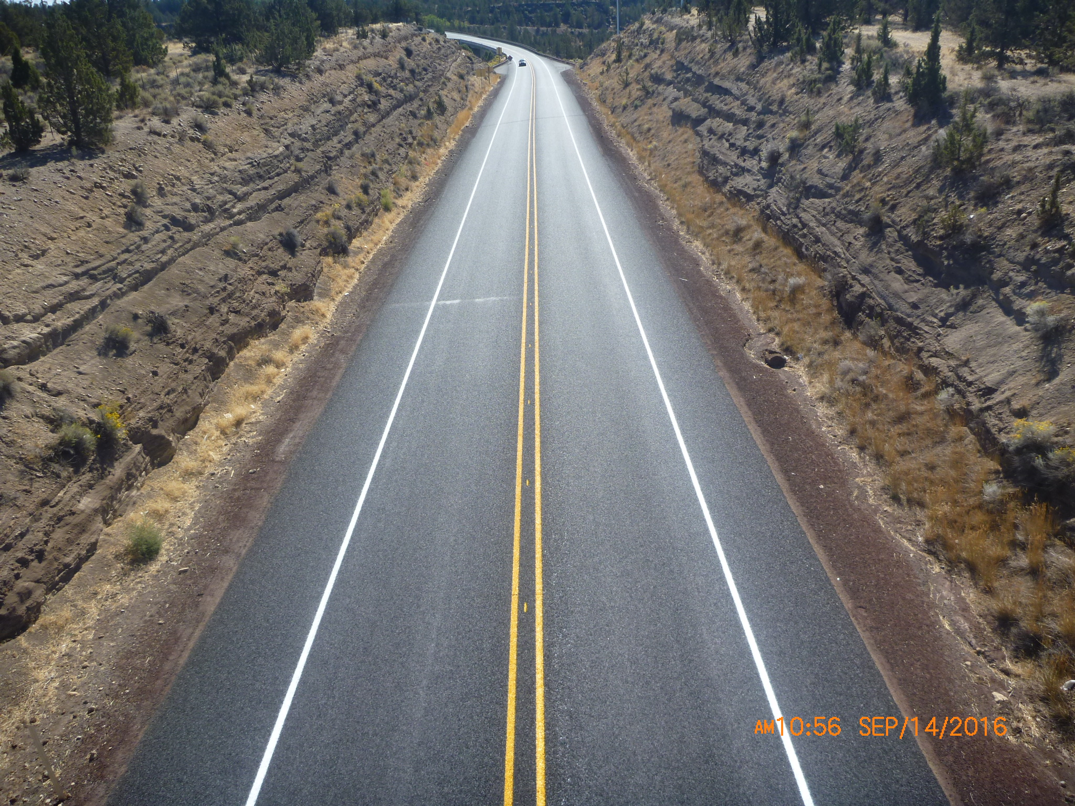

Slide 14
US97
7.0 roadway miles
Placed late August
Oil was HFRS-P2
Rock was 3/8” – ¼”
Fog Coat
fly rock was an issue, utilized choke material
Notes:
Items to note on this section:
The chip was applied in late August with favorable weather, one afternoon highs into 90’s. Otherwise highs in the 80’s. The aggregate was washed and very clean. Average rates were 25 lb/sy of rock and 0.45 gal/sy of oil.

Slide 15
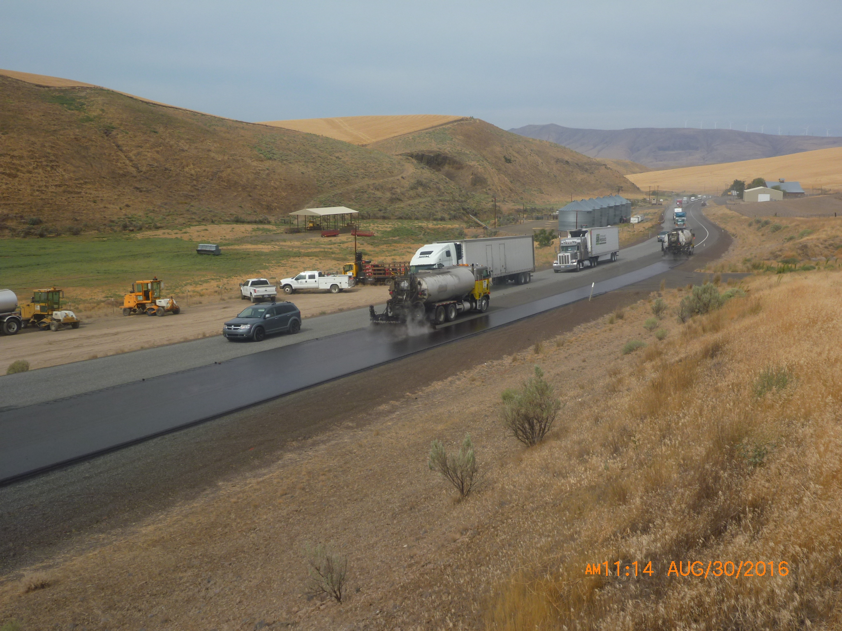

Slide 16
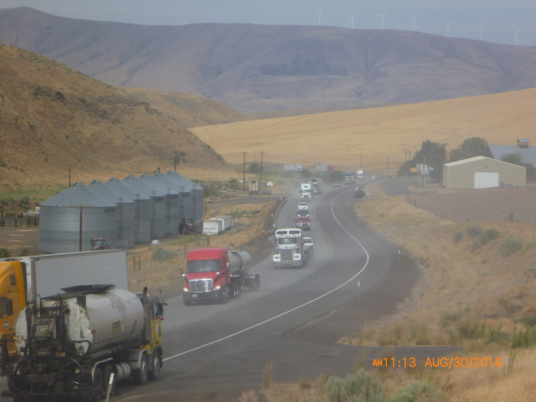

Slide 17
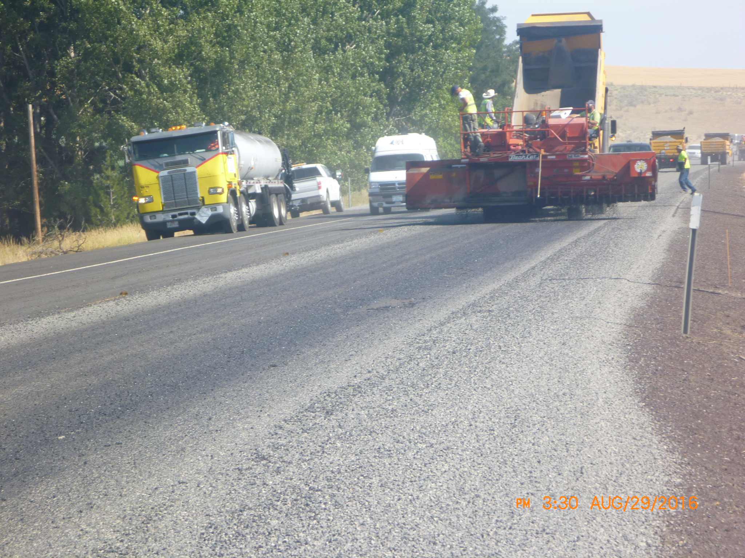

Slide 18
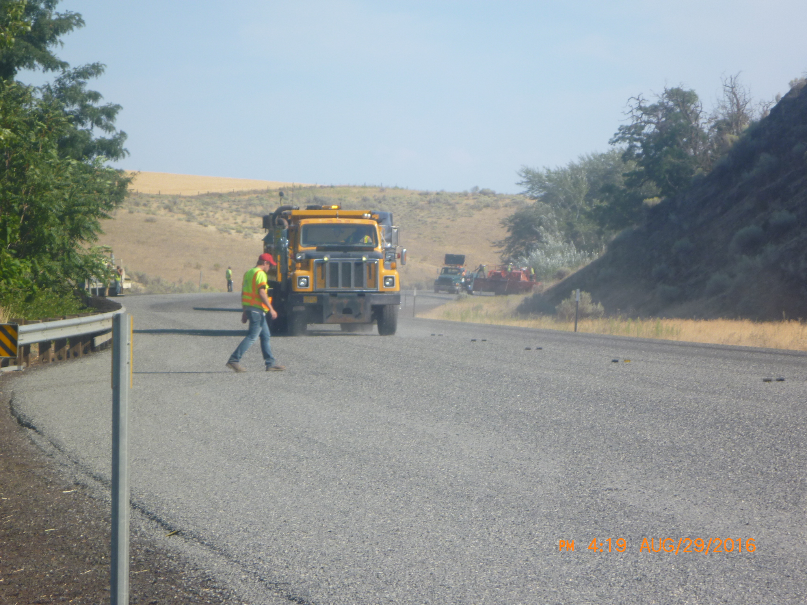

Slide 19
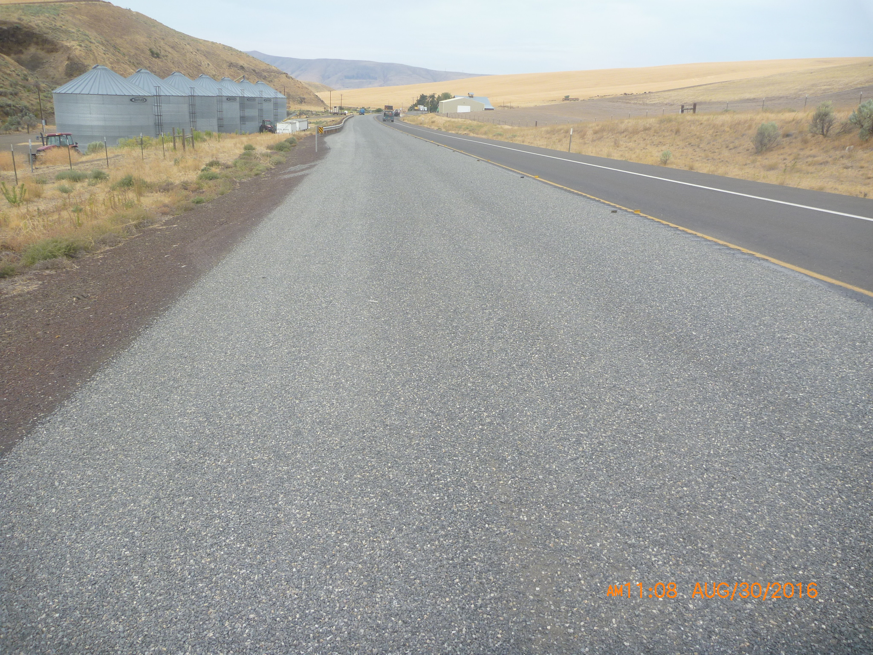

Slide 20
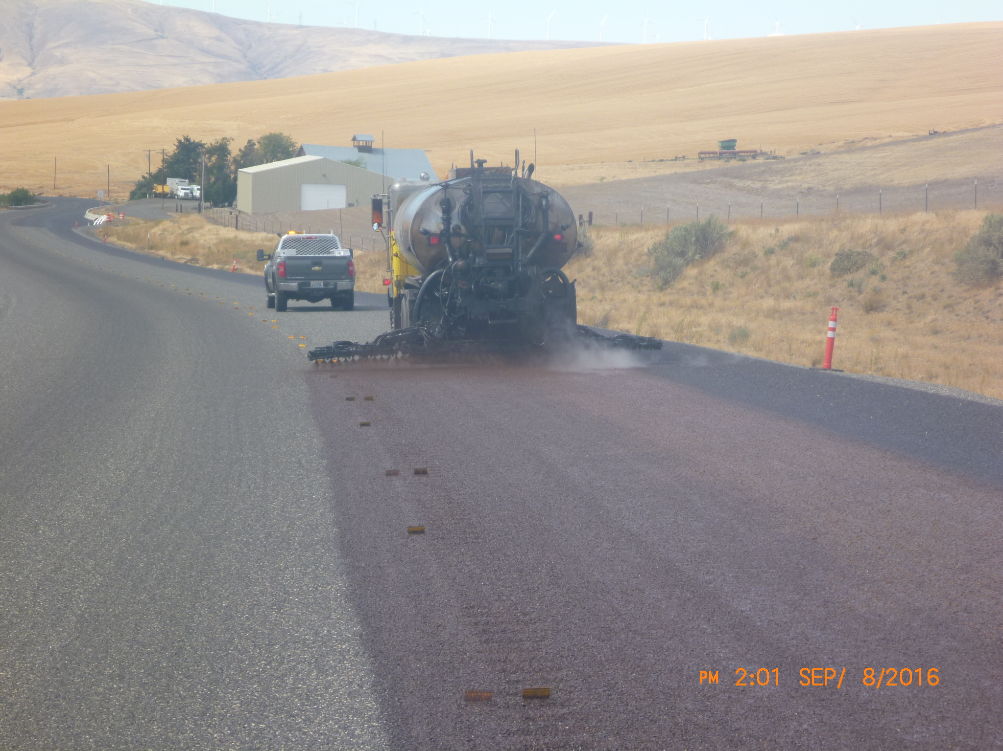

Slide 21
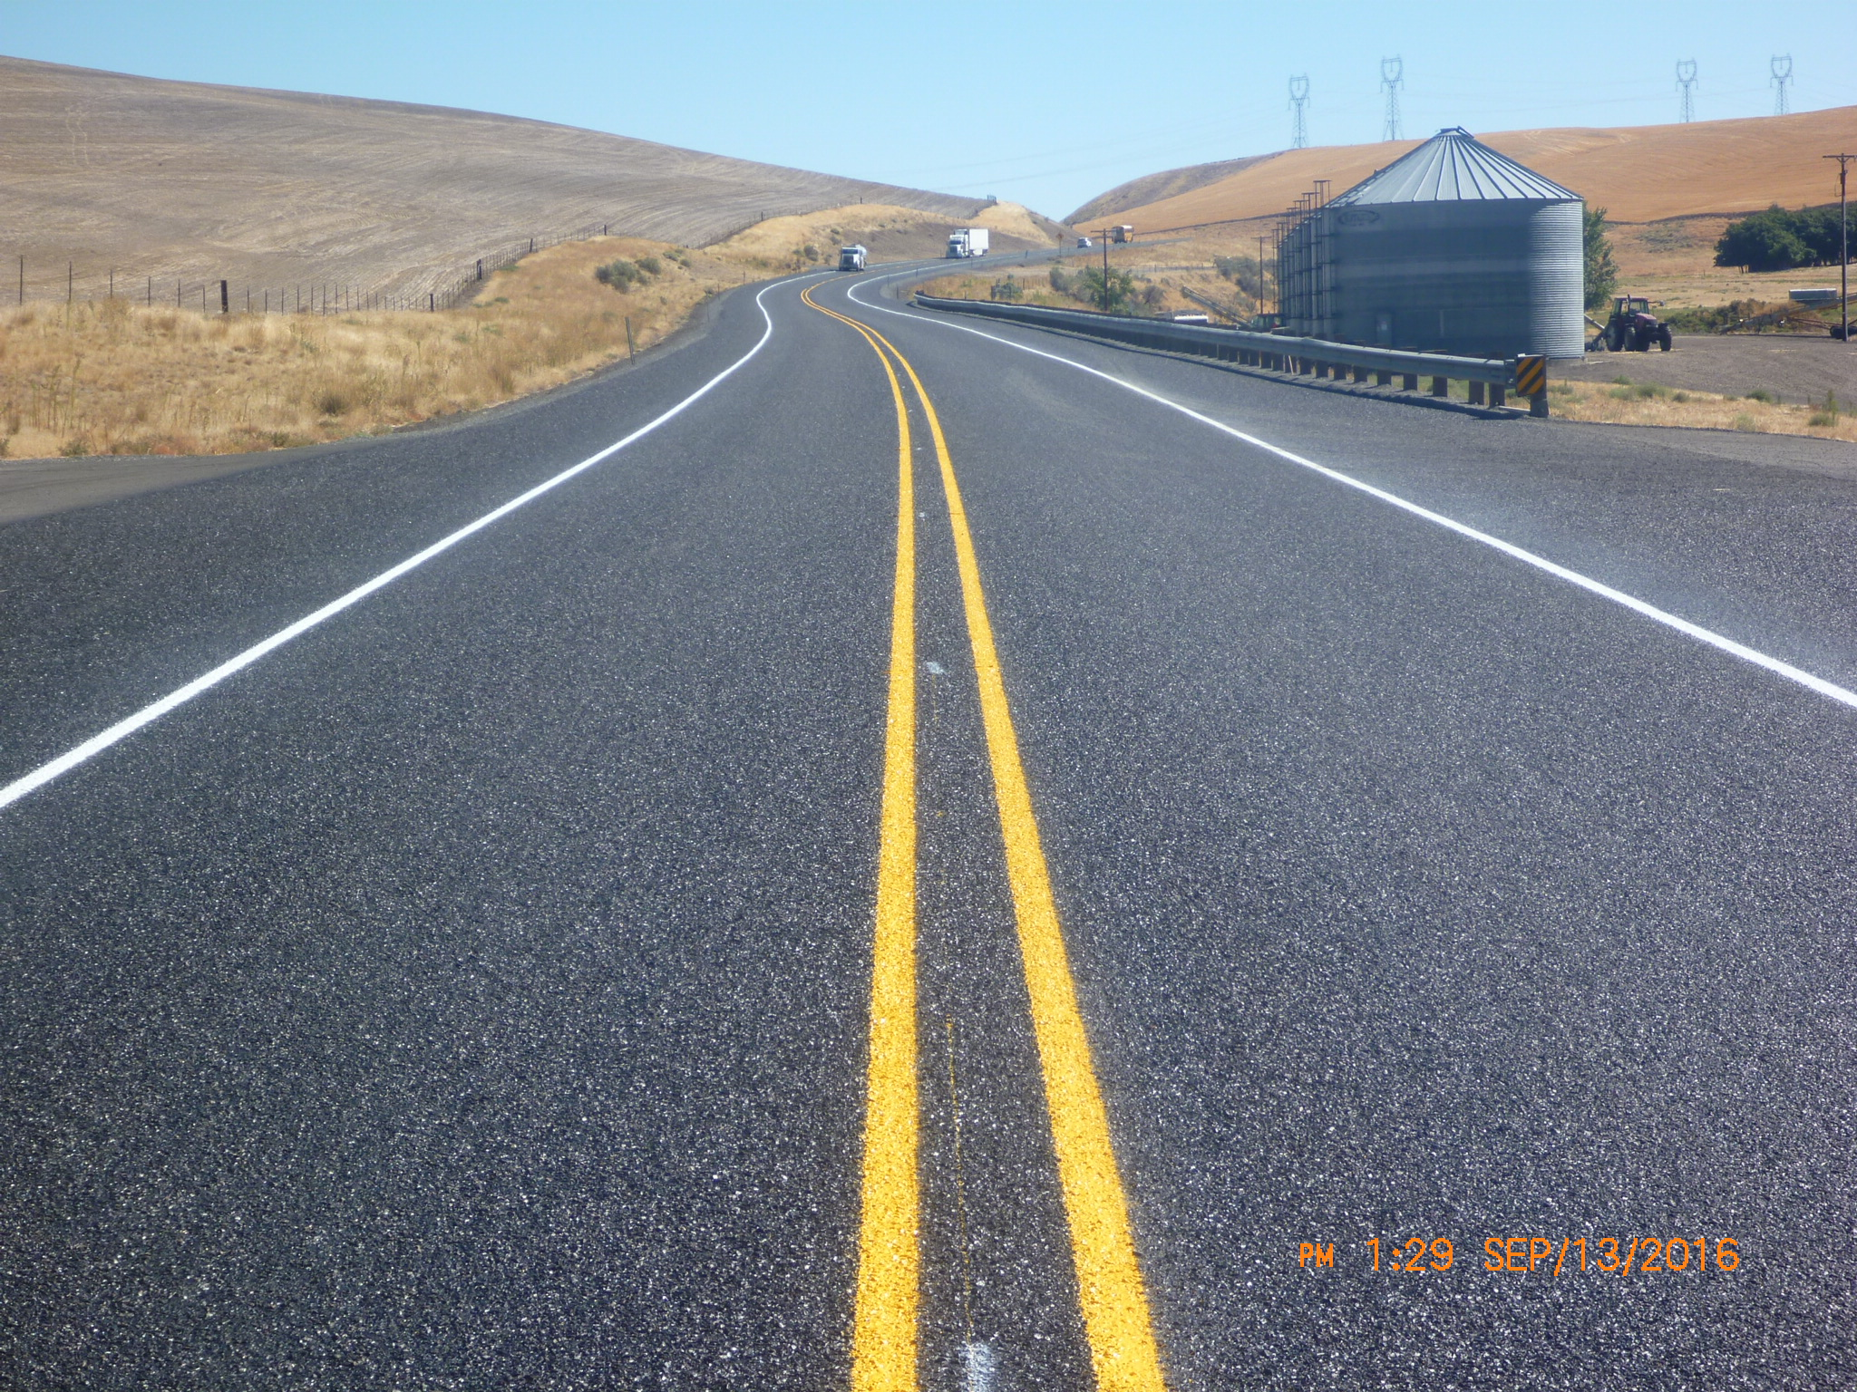

Slide 22
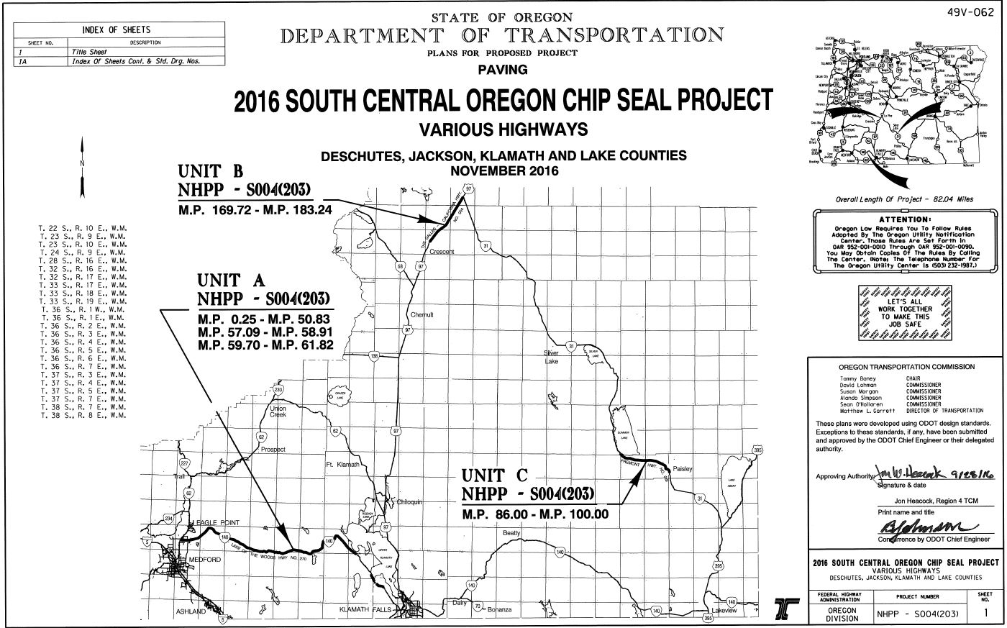

Slide 23
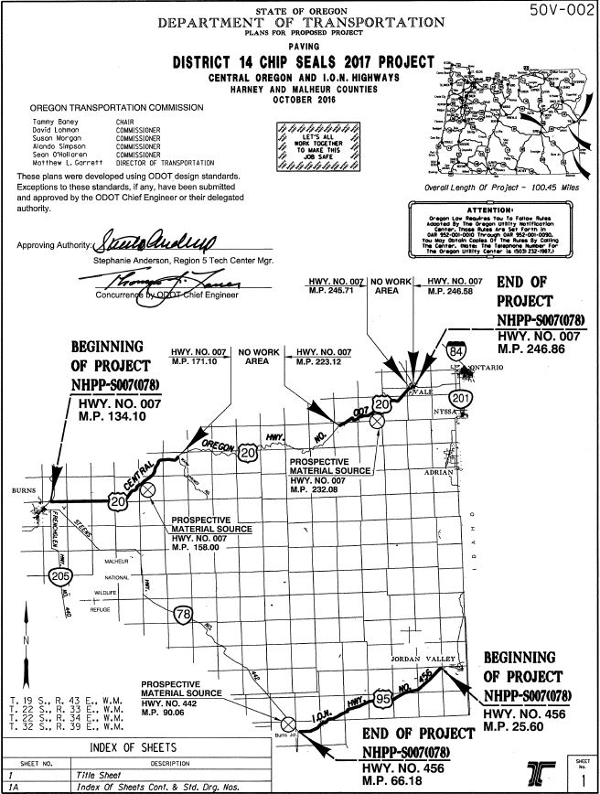

Slide 24
Thanks

