Slide 1
Work Zone Traffic Control
Chip Seal Operations
Challenging Operation to Complete WZTC
  The work zone is constantly moving & changing
  Frequently have long work zones - side roads
  Busy and congested work areas
      (Distributor, chip spreader, numerous trucks, brooms, rollers, work zone vehicles and support vehicles)
  Work is adjacent to moving traffic (often on narrow roads)
  The work itself is “unfriendly” (dust, loose and flying rock and fresh oil) – ripe for claims
  Most operators lack staff to complete WZTC

Slide 2
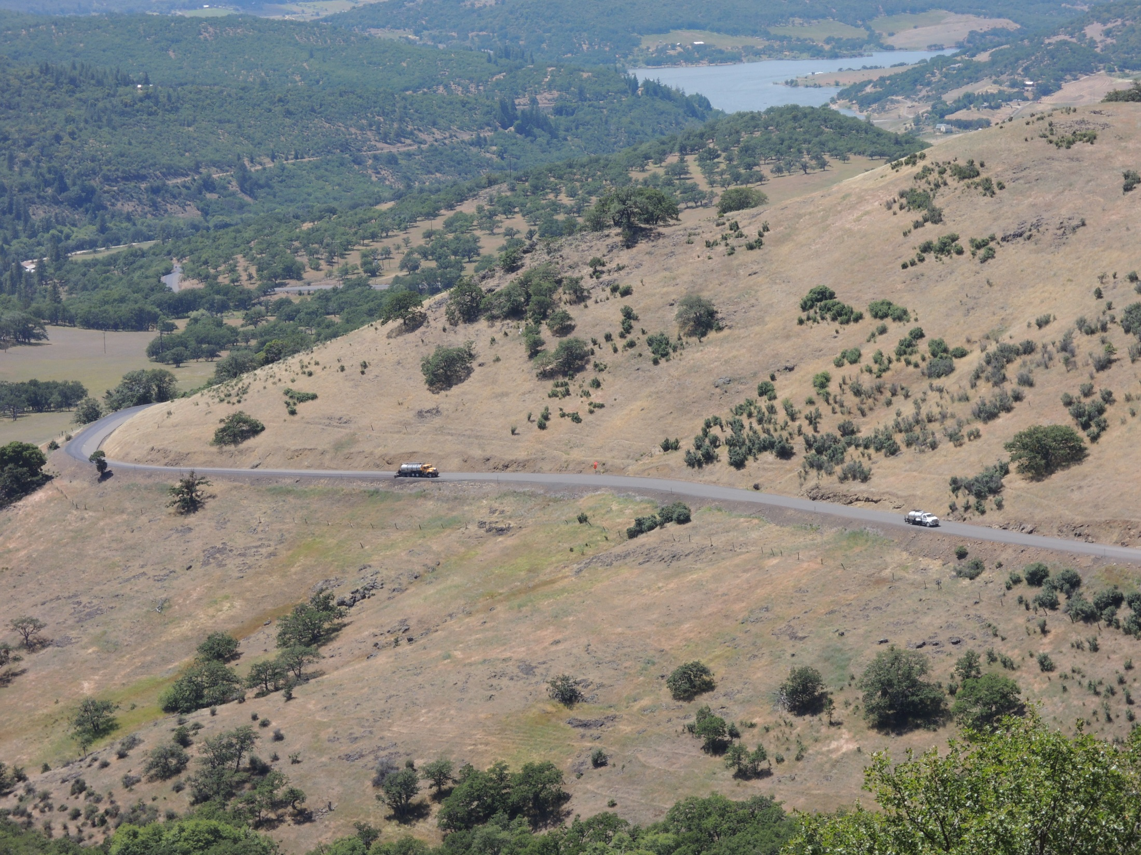

Slide 3
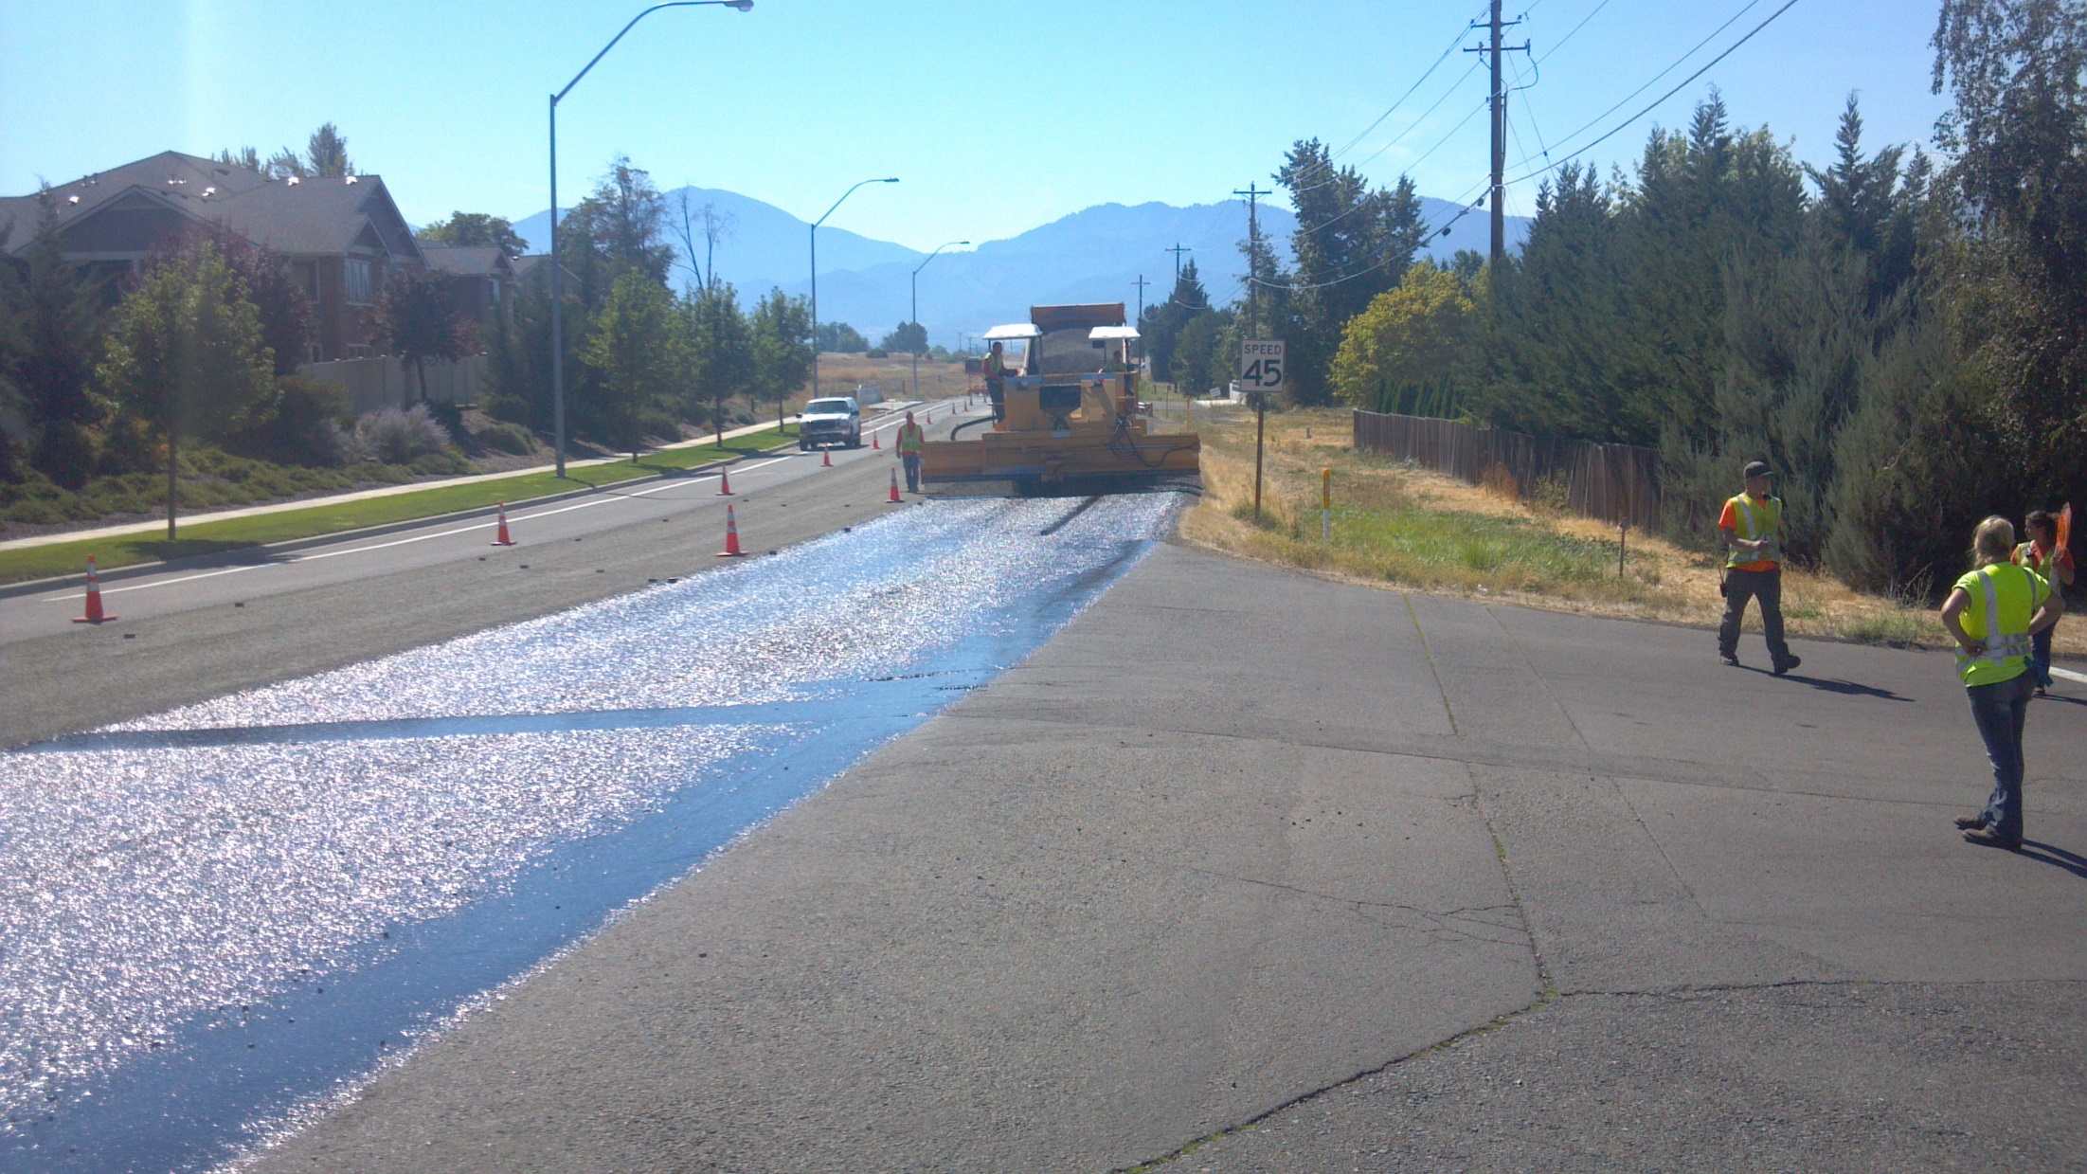

Slide 4
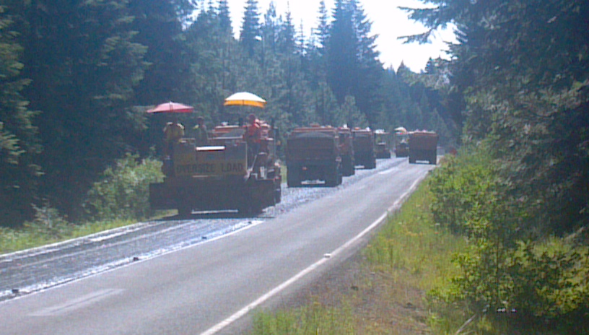
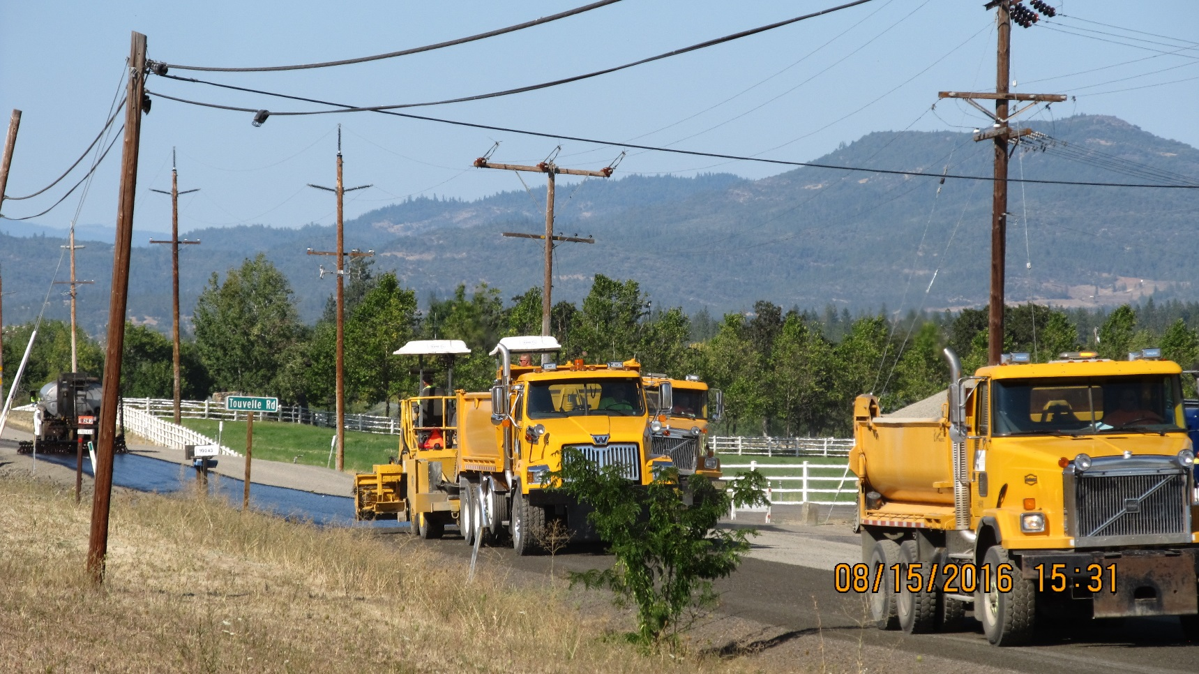

Slide 5
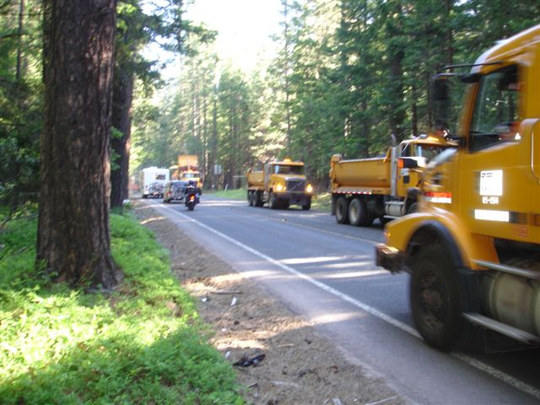
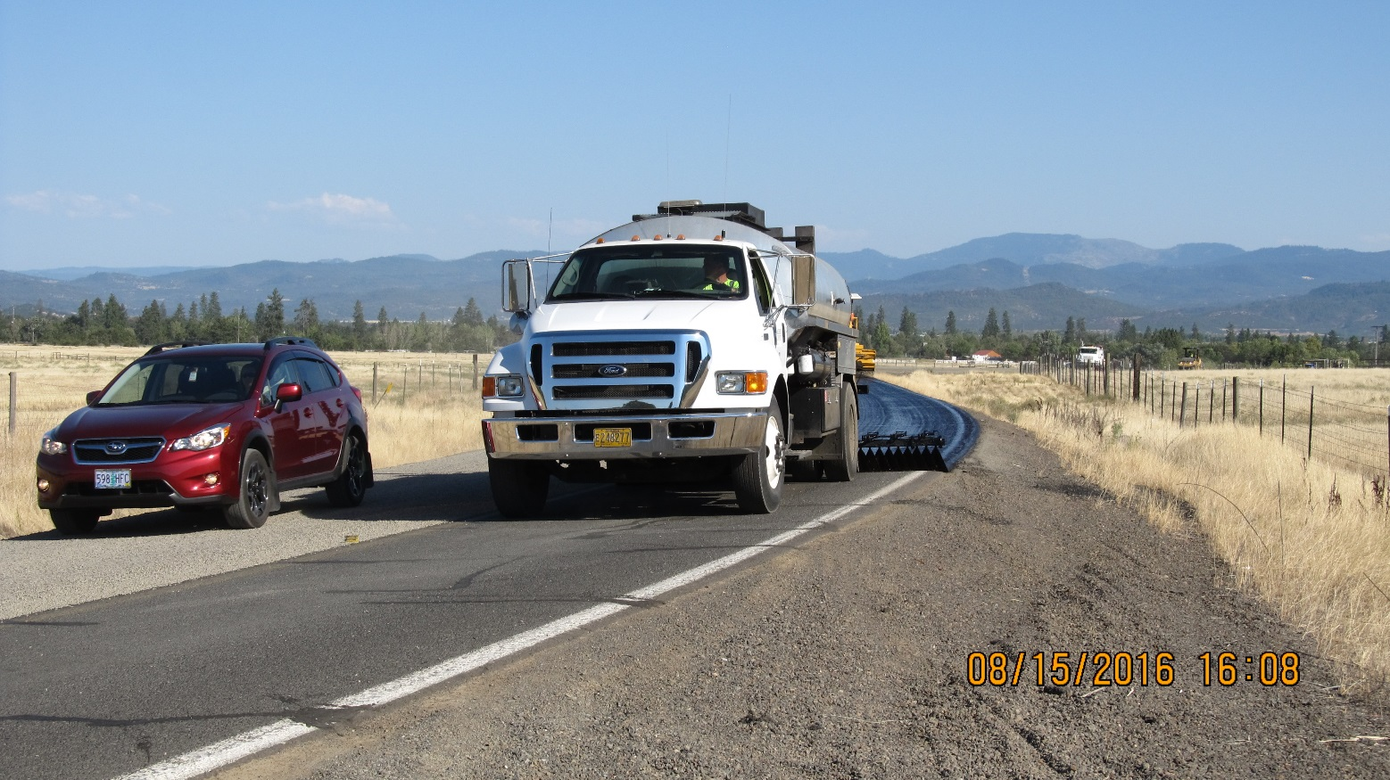

Slide 6
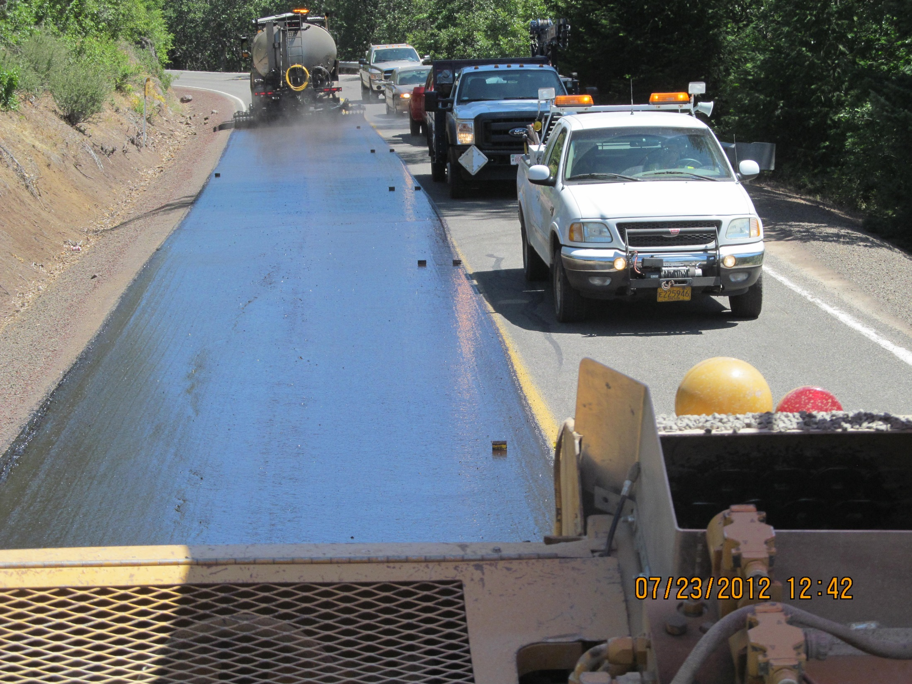

Slide 7
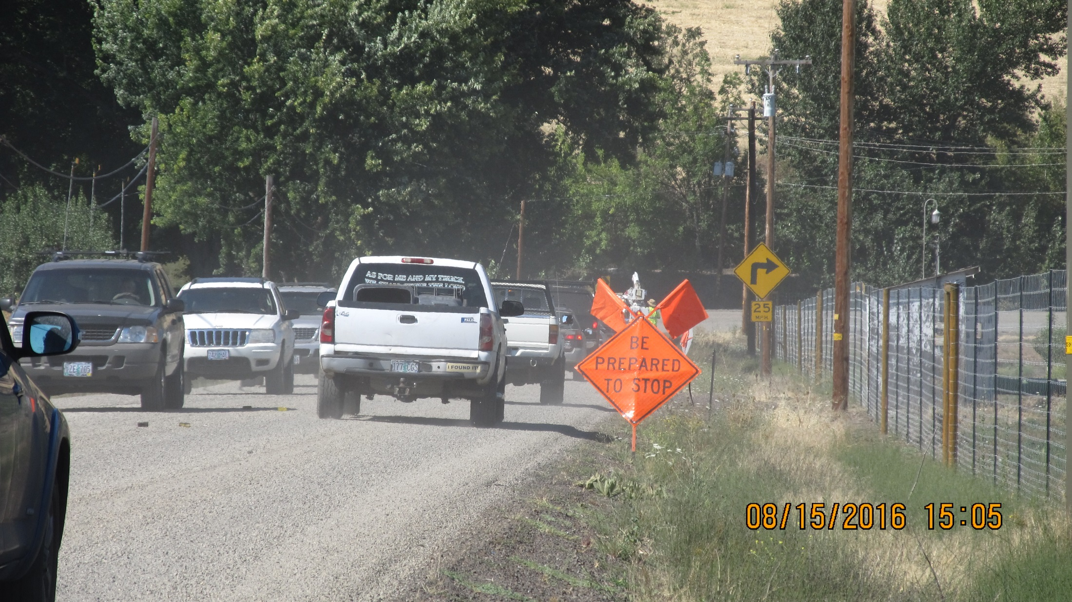

Slide 8
Work Zone Traffic Control
Chip Seal Operations
ORS 810.200
The Oregon Transportation Commission may exercise the following authority with respect to the marking, signing and use of traffic control devices in this state:
(a) The commission shall adopt a manual and specifications of uniform standards for traffic control devices consistent with the provisions of the vehicle code for use upon highways in this state.

Slide 10
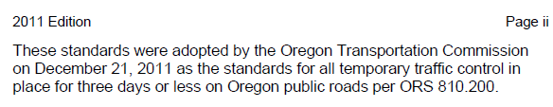
Budget Overview
Oregon Temporary Traffic Control Handbook December 2011
By way of Oregon law, all local governments should (must) use this handbook for all temporary traffic control completed by our forces.
My guess is that most of us fall short of fully meeting these WZTC standards.
Creates risk and liability for us as we are not following published standards.
Notes:
Review each

Slide 11
Oregon Temporary Traffic Control Handbook December 2011
Chip Seal Traffic Control
No single diagram will work for all chip seal operations – Get as close as you can to the “Book”
More than one proper work zone and the work changes
  Completing the laydown
  “Loose rock” phase (before final brooming)
  Work complete except for striping
    – how do you sign this?

Slide 12
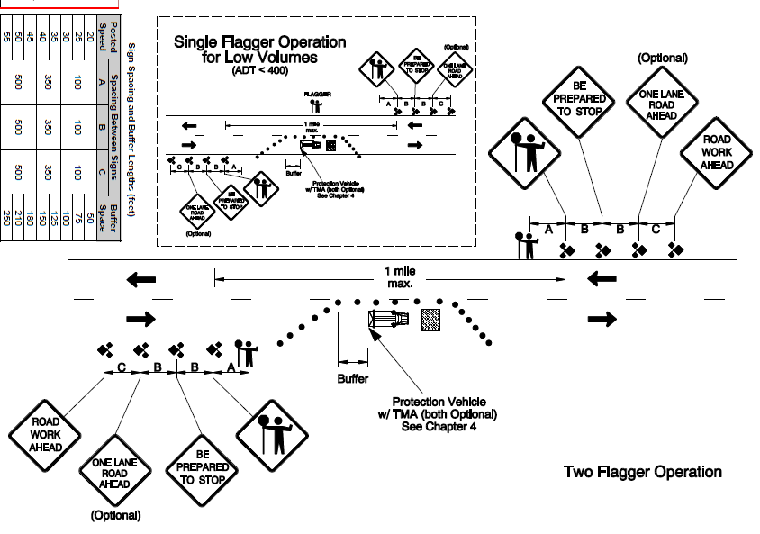
Jackson County Roads & Parks
Stationary Closure with Flaggers
(Diagram 320)

Slide 13
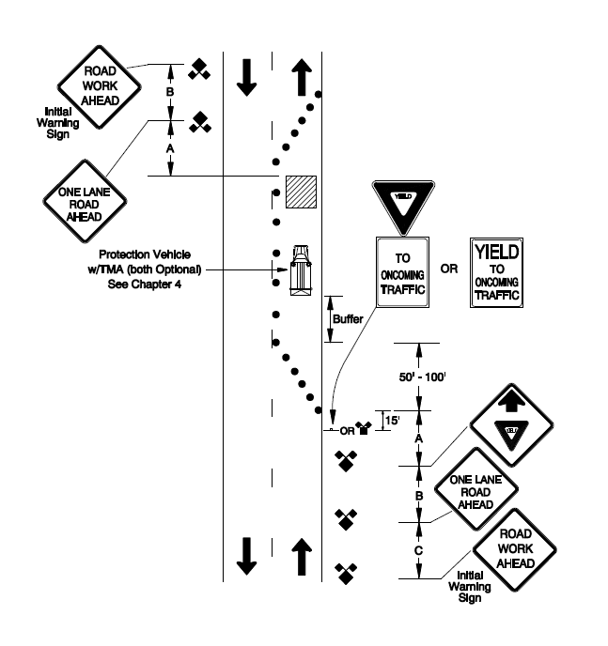
Standard notes that this can only be used for work spaces of 200 feet or less
Self-Regulating Lane Closure
(Diagram 350)

Slide 14
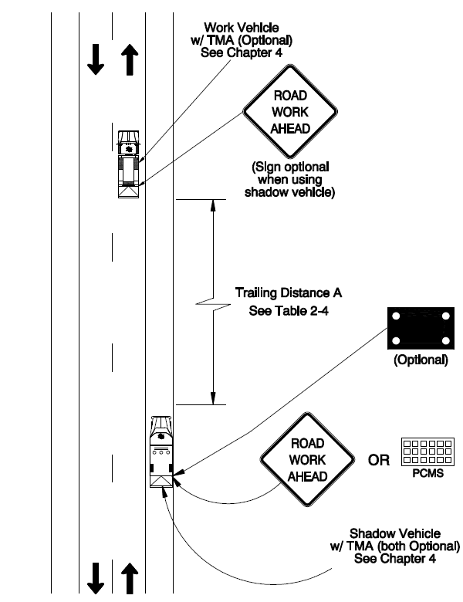
Very questionable application for a chip seal operation
Mobile Operation on Two-Lane Roads
(Diagram 110)

Slide 15
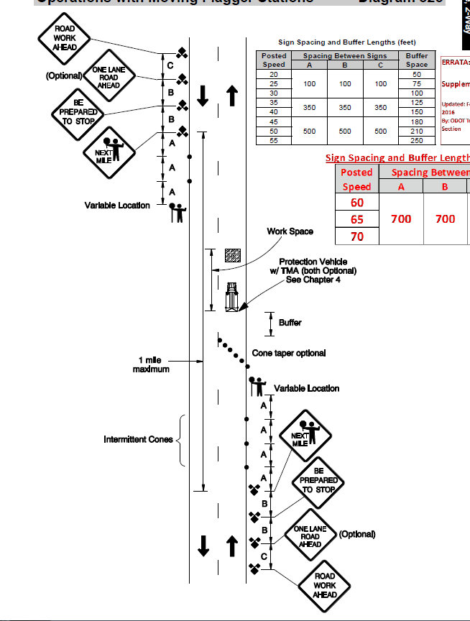
Difficult to use with most chip seals
Work zone shouldn’t exceed 1-mile (…shall not exceed)
Problems with trucks entering and exiting the live lane
Operations with Moving Flagger Stations
(Diagram 325)

Slide 16
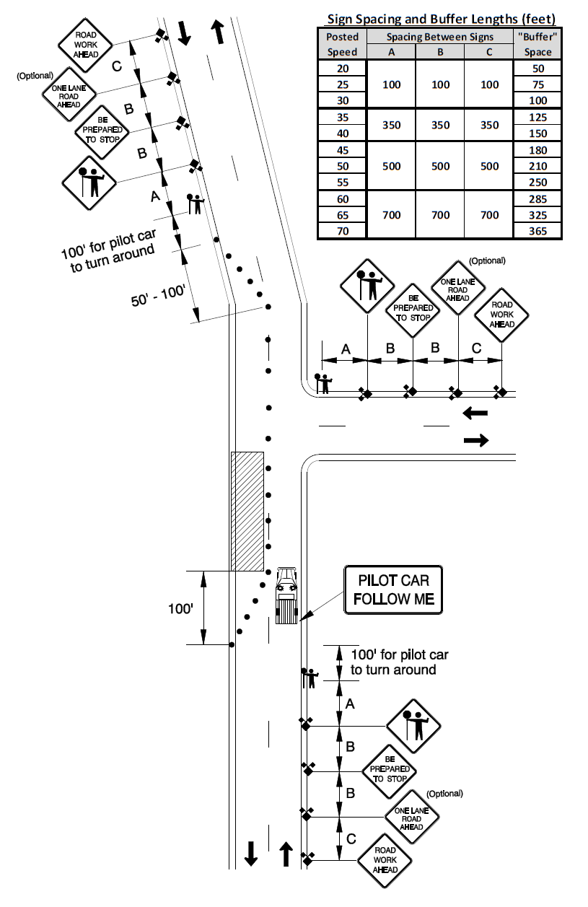
Generally the preferred option work zone for chip seals
Takes more people
Cones are optional
ONE LANE ROAD AHEAD is also optional
Lane Closure w/ Pilot Car
(Diagram 340)

Slide 17
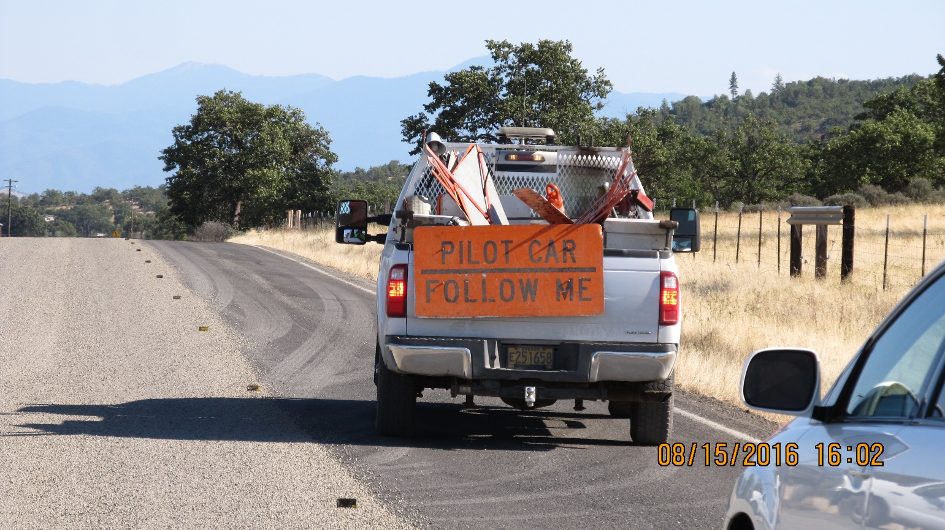
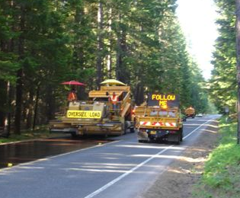
Pilot cars recommended when drivers cannot see from one flagging station to the next
Work zones should not exceed 3-5 miles
Flaggers and pilot shall be in radio contact

Slide 18
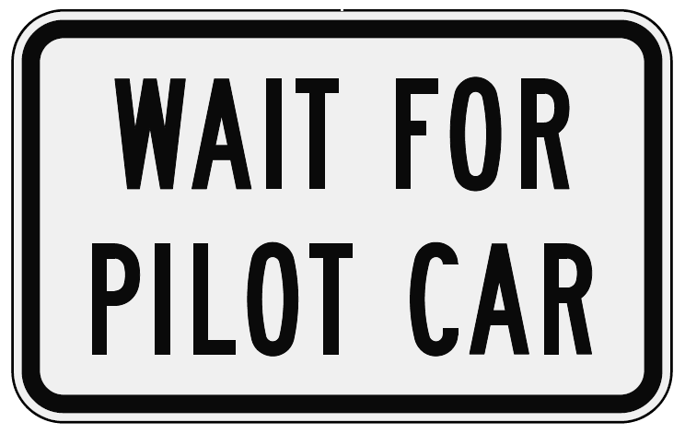
“WAIT FOR PILOT CAR” signs allowed on side roads < 100 ADT

Slide 19
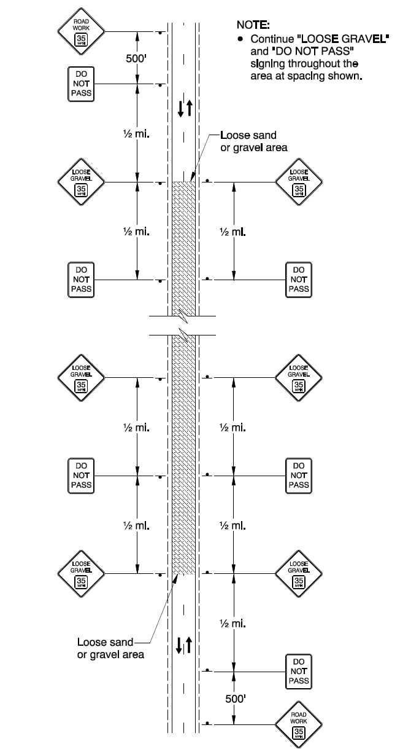
Chip sealing requires additional signs needed beyond the standard WZTC
Many local governments struggle in complying with this standard
  Don’t have the correct signs
Come as close as you can
Oiling and Chip Seal Operations
(Diagram 345)

Slide 20
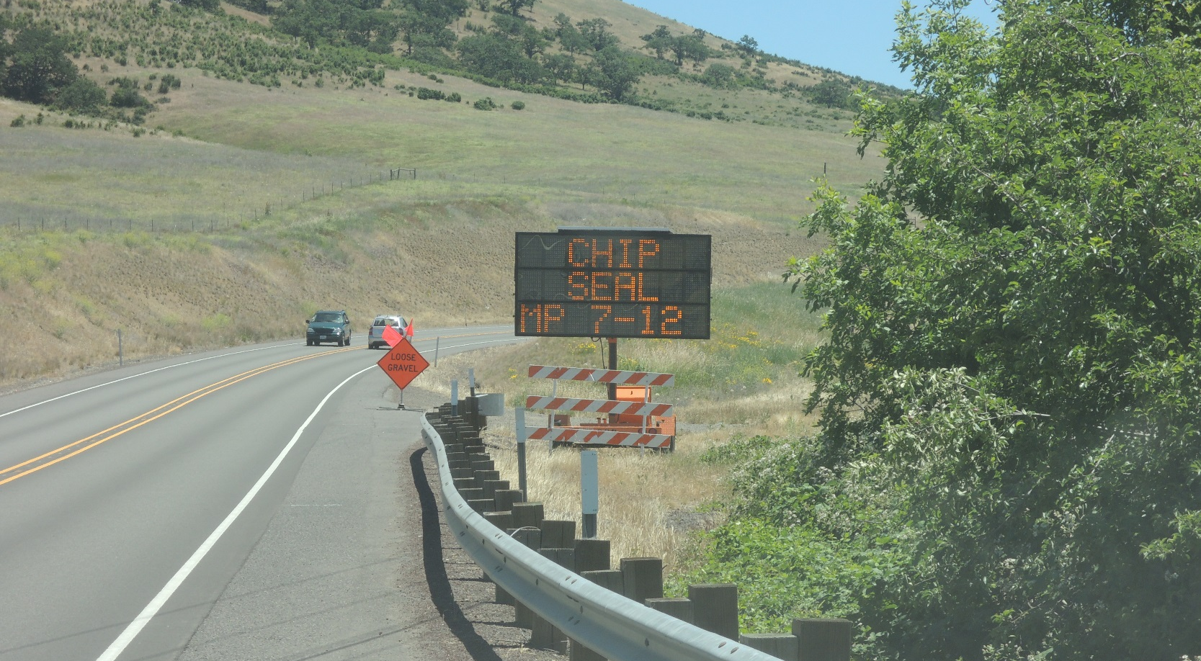
Changeable Message Signs
Advance placement (at least one week) of CMS highly recommended on busy roads
Continue to use during the project
Not required, but use them if you can

Slide 21
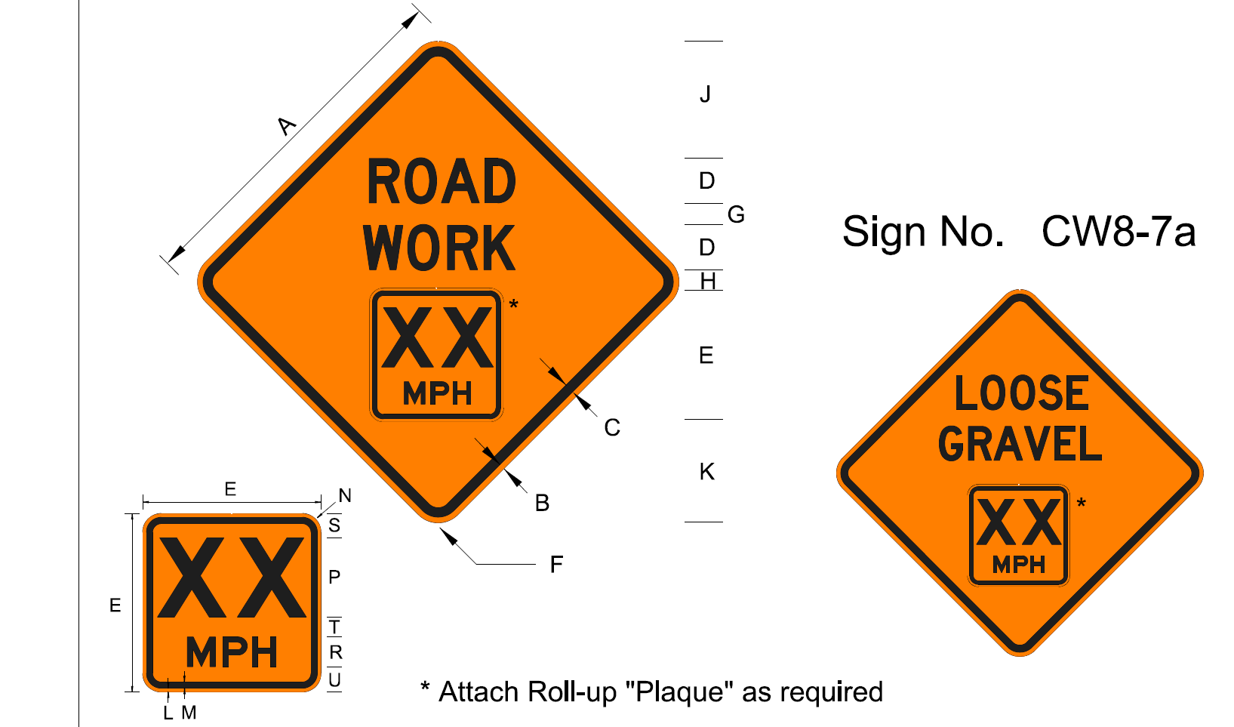
Speed Reduction Signs
Current Standard

Slide 22
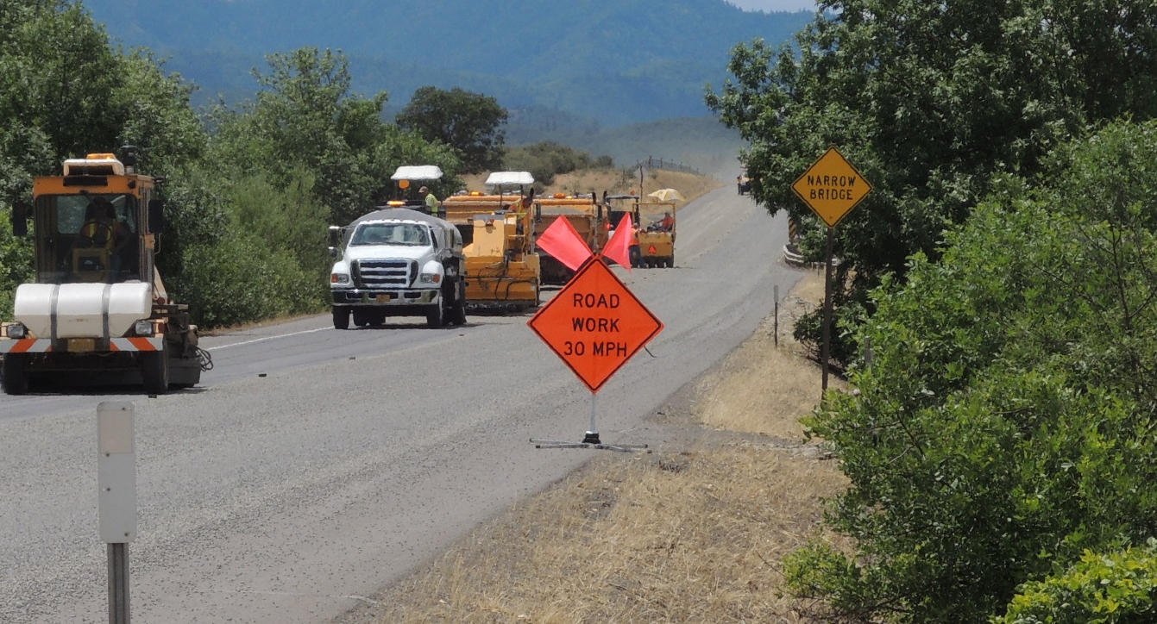
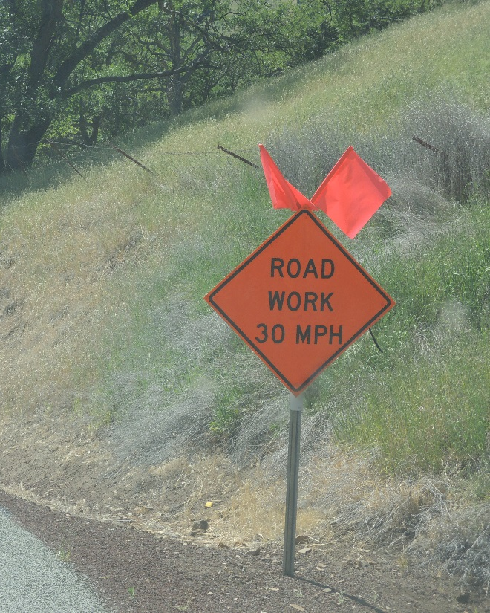
Speed Reduction Signs
Standard requires using reduced speed signs but leaves the actual speed limit undefined
(“…typical speeds used range from 30-35 mph”)
Non-regulatory speed sign
(don’t use black on white)

Slide 23
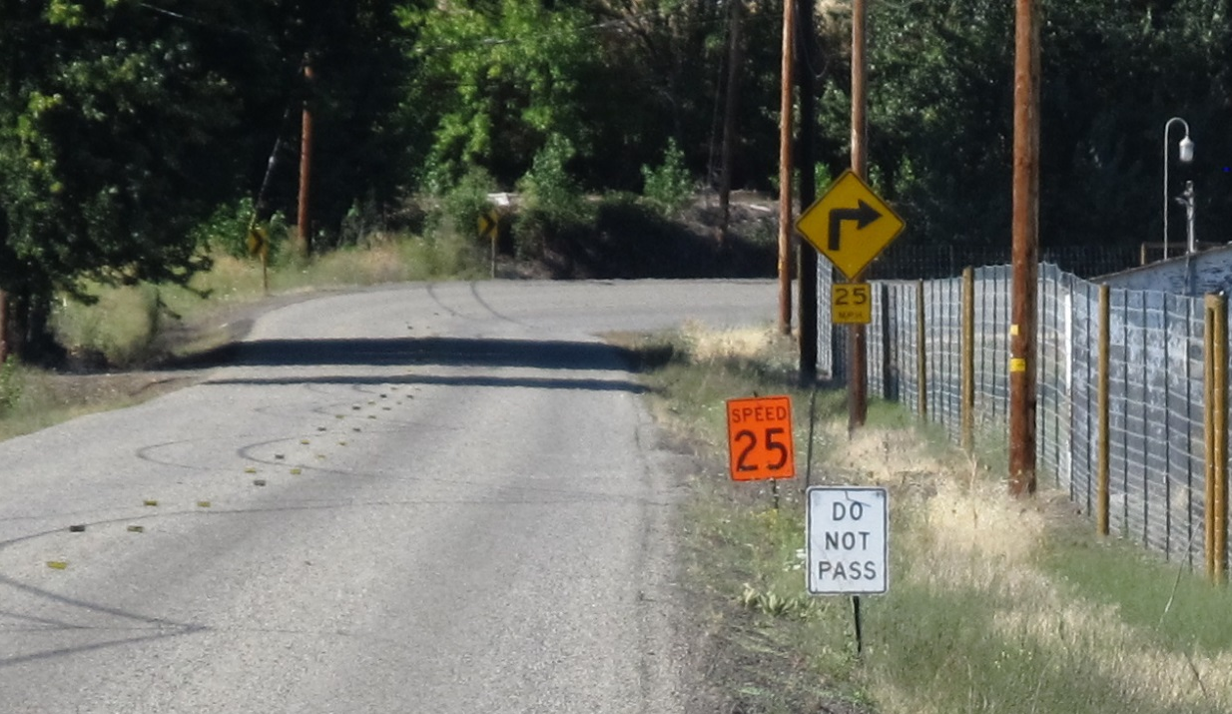
Speed Reduction Signs
Is this Speed Sign “allowed”?

Slide 24
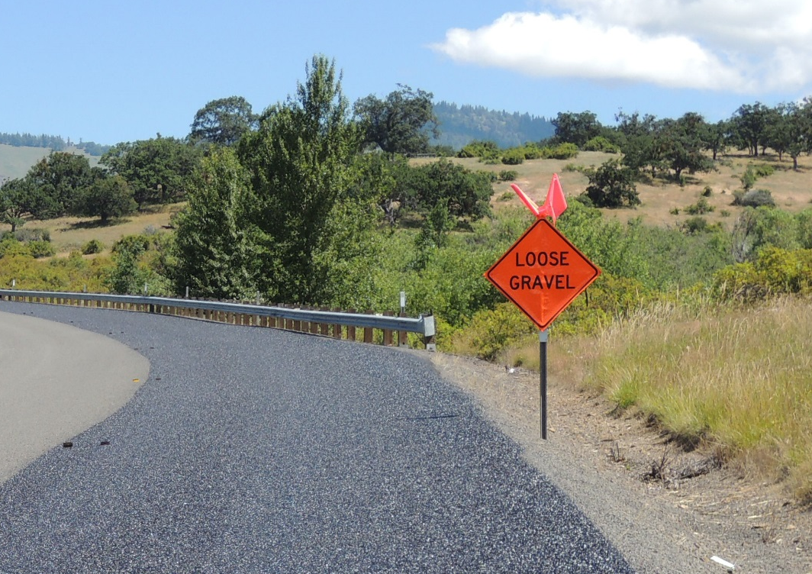
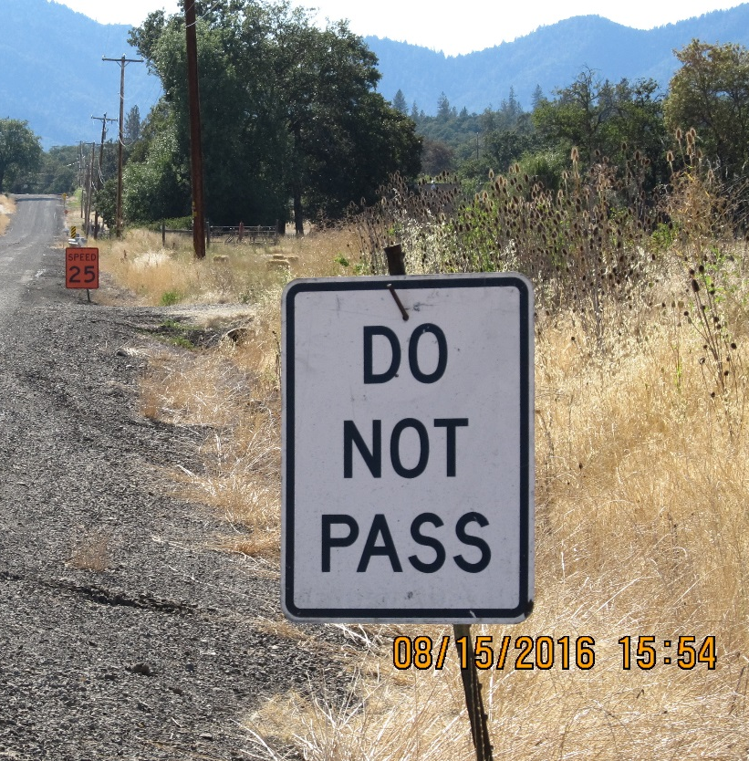
LOOSE GRAVEL and DO NOT PASS Signs

Slide 25
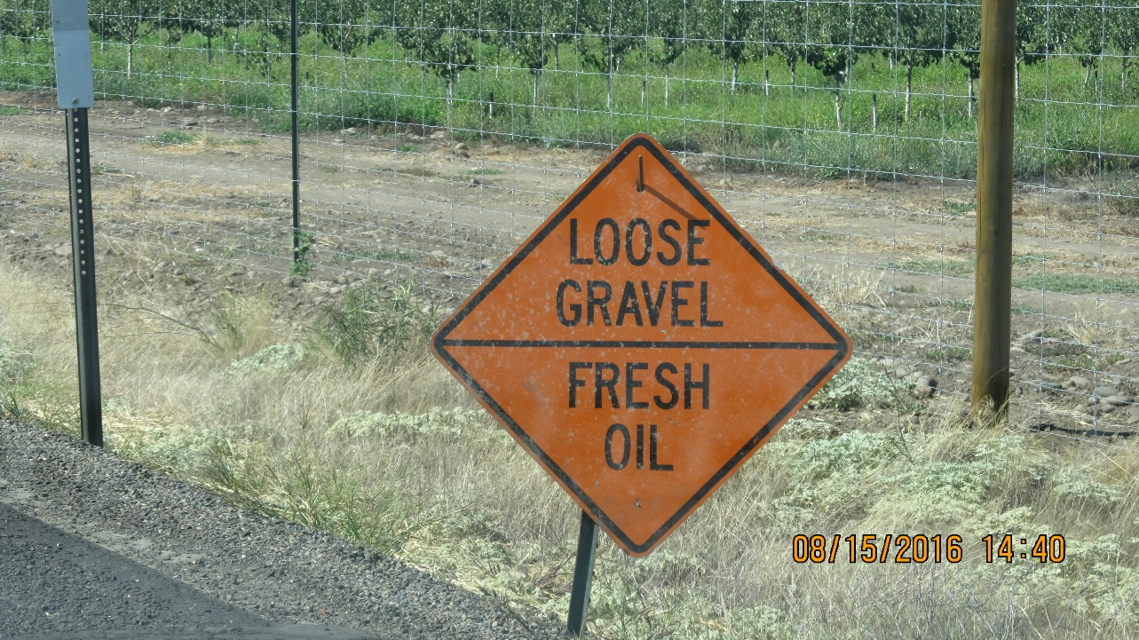
LOOSE GRAVEL and DO NOT PASS Signs
LOOSE GRAVEL, DO NOT PASS and SPEED XX Signs should be spaced at ½ mile
LOOSE GRAVEL and SPEED XX Signs need to be Black on Orange (construction signs)
DO NOT PASS signs should be Black on White

Slide 26
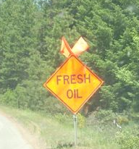

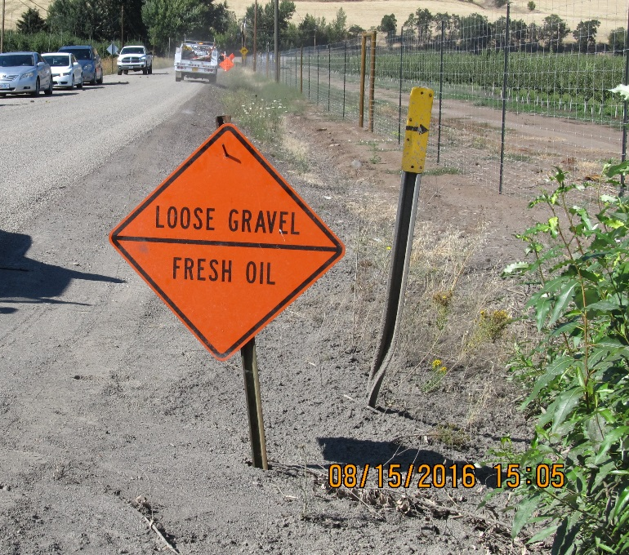
“Other” signs
Not Currently Required
Generally, as long as it’s an allowed sign, nothing wrong with using them

Slide 27
Oiling and Chip Seal Operations
(Diagram 345)

Slide 28
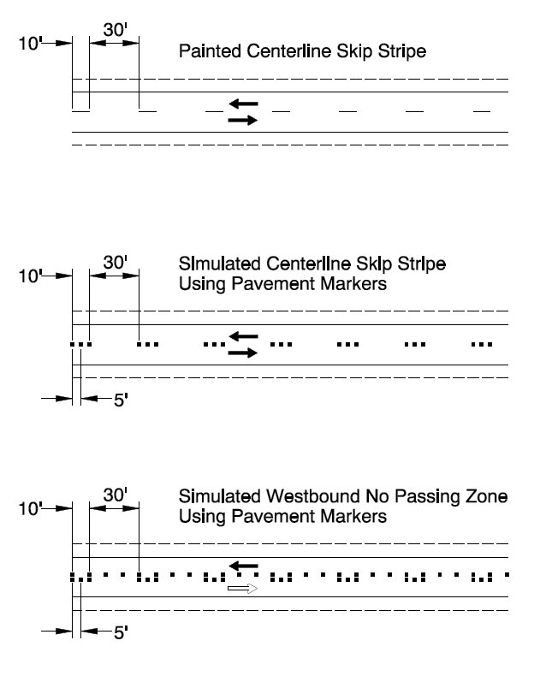
ADT < 5000, ≤ 45 mph or
ADT < 10,000, < 45 mph
(1) marker every 40’
marker every 20’
(posted curves & channelizations)
ADT > 5000 ≥ 45 mph or
ADT > 10,000 < 45 mph
(3) markers @ 5’ on skip stripes w/ 30’ gap
Solid lines – (1) marker every 10 feet
Temporary Pavement Markers
(Diagram 5-10)

Slide 29
Work Zone Traffic Control
Chip Seal Operations
Recommendations
Become familiar with and use the Oregon Temporary Traffic Control Handbook - it is law
Work towards replacing signs that are not compliant with current standards
In areas with lots of side streets - pre-set signs
Consider adding WAIT FOR PILOT CAR sign on side streets
If the project is being done in high traffic areas, consider having dedicated traffic control staff

Slide 30
Work Zone Traffic Control
Chip Seal Operations
Recommendations
Changeable Message Signs – use them. Truck mounted can be very helpful.
Review your use of temporary traffic markers – many of us are not in compliance
½ mile spacing and don’t “bunch up” the LOOSE GRAVEL, DO NOT PASS AND SPEED XX SIGNS
Partner with your local law enforcement to help keep speeds down
Be safe and don’t take chances

Slide 31
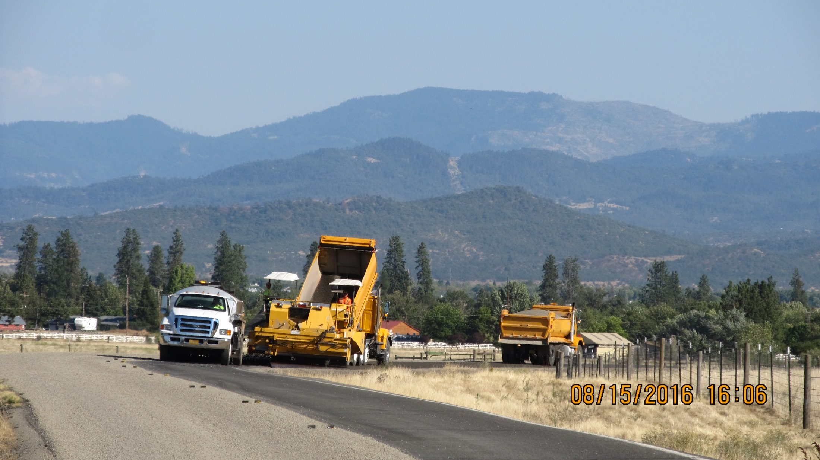
Work Zone Traffic Control
Chip Seal Operations
Questions?

