Slide 1
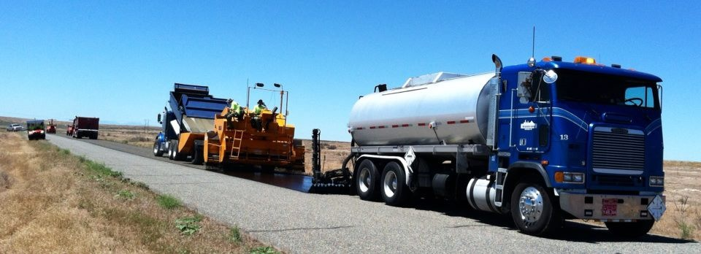
Blue line (BL) – pavement preservation system
Blue Line Transportation Co. Inc. © 2014

Slide 2
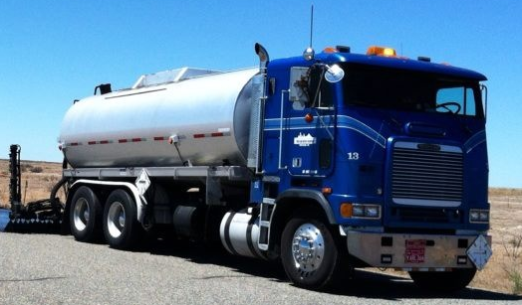
BL - Pavement Preservation System
Quality you can trust
When purchasing the BL line of products you are not only getting engineered products manufactured to stringent ISO and AASHTO standards you also receive transportation, application and technical service of unequaled performance that streamlines your program.

Slide 3
BL - VALUE ADDED SERVICES

Slide 4
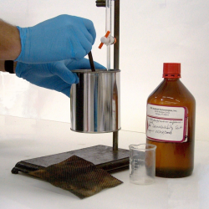
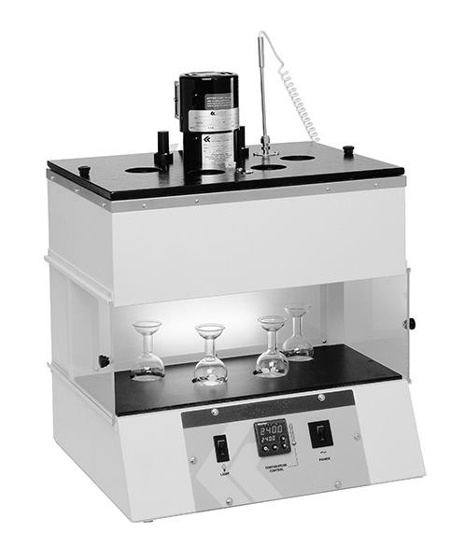
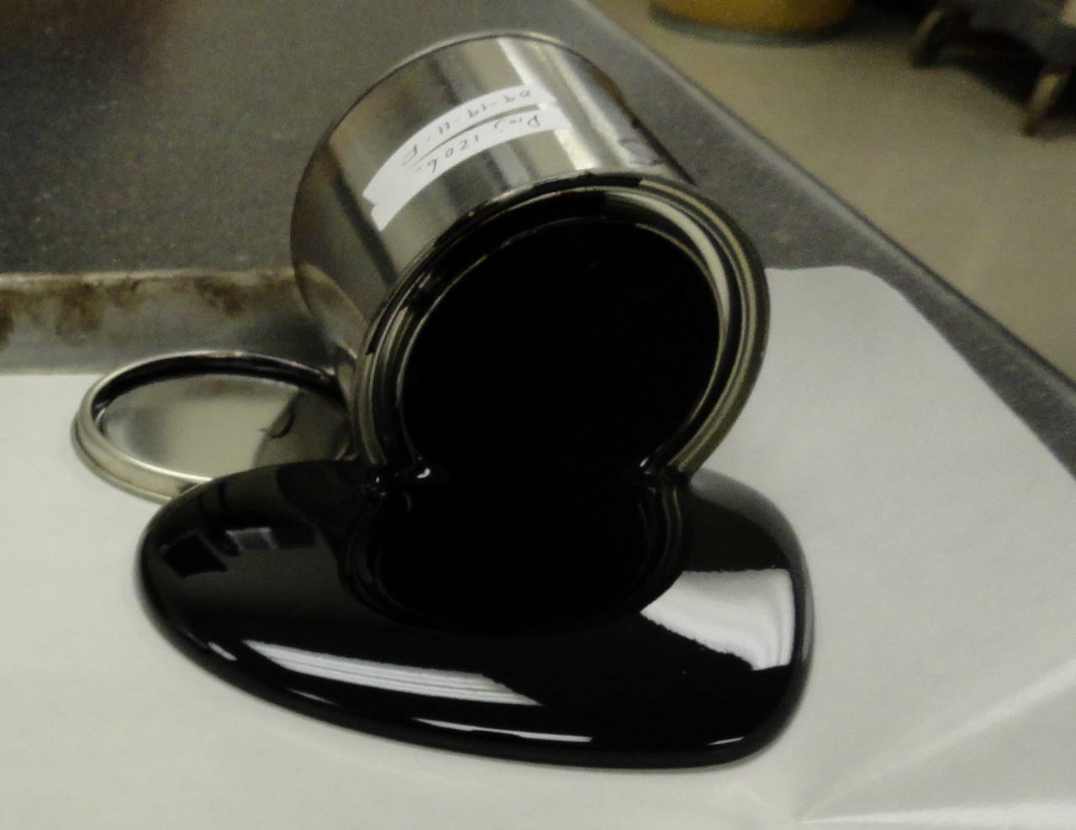
Technical Services
With over 100 years of combined experience, BL technical services provide the means to engineer products that will meet your expectations.

Slide 5
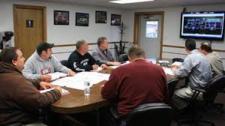
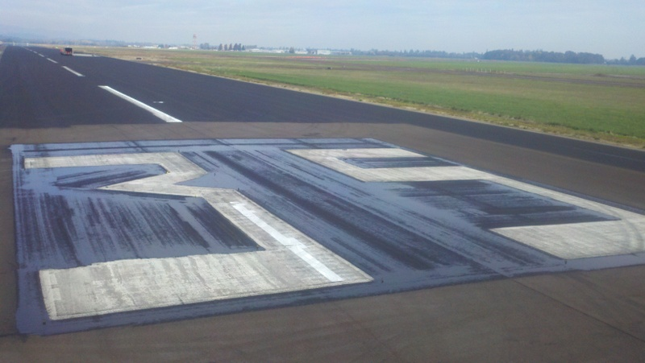
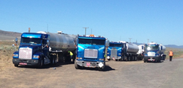
Dispatch, Application and Transportation
Streamlining the construction process meets budgets and ensures maximum force multiplication of work crews.
24/7/365 Dispatch
Dedicated Distributors and Transports
Class 1 Operators

Slide 6
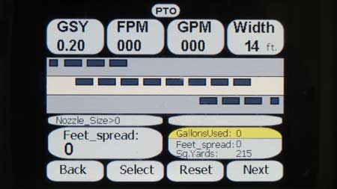
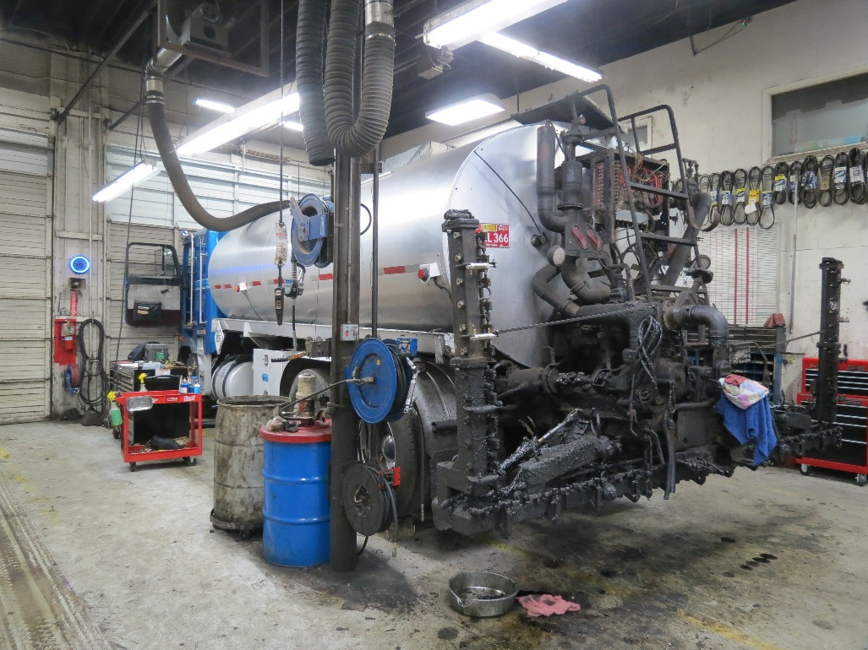
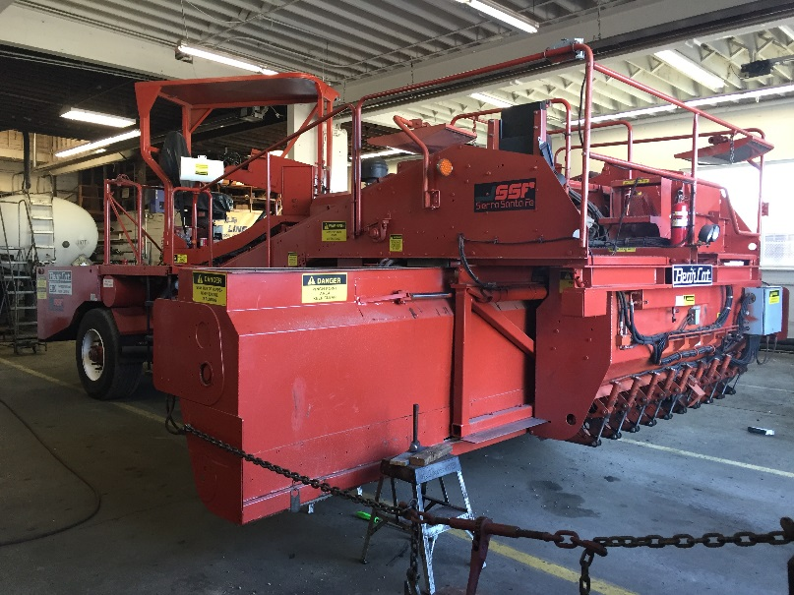
Maintenance, Repair and Certification
Quality workmanship starts with the proper tools in working order and that is attained through the utilization of our R-stamp maintenance and repair facility.

Slide 7
BL – PRODUCTS

Slide 8
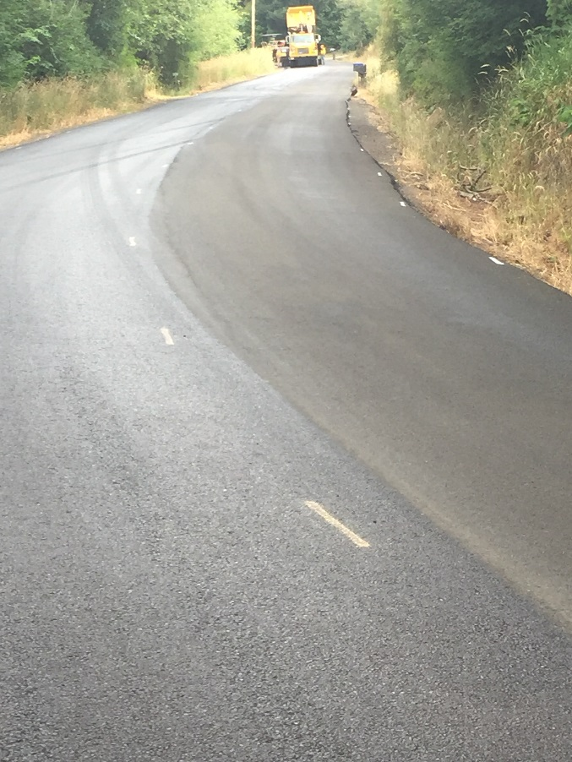
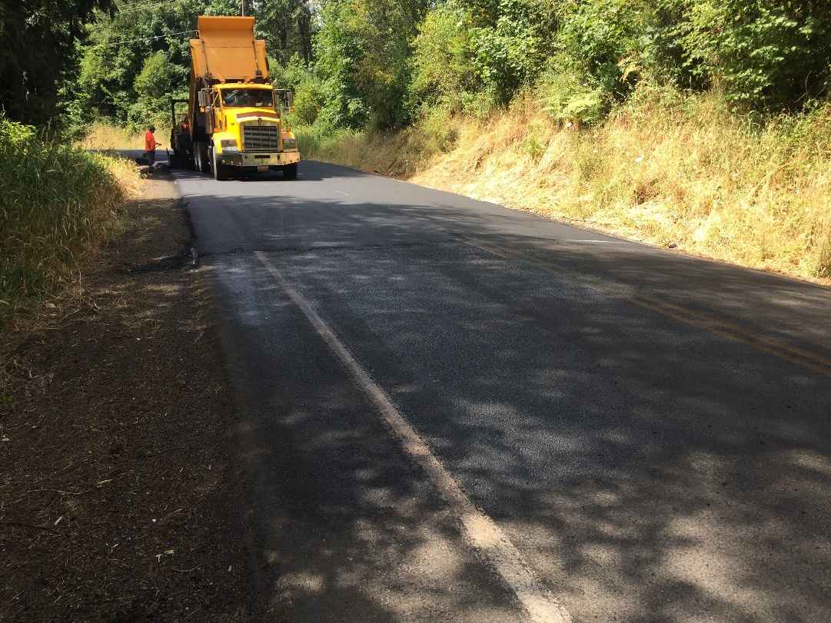
Bl–hrt (high residue tack)
BL-HRT is an engineered high residue tackifier utilized in the paving industry to achieve excellent bonding, fast curing and minimal tracking characteristics.

Slide 9
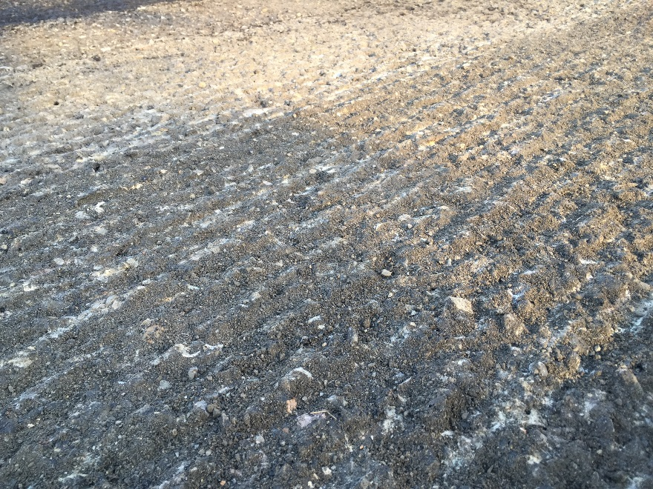
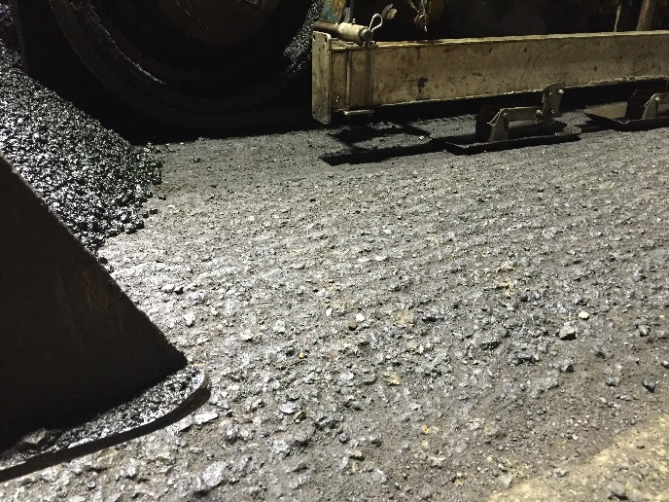
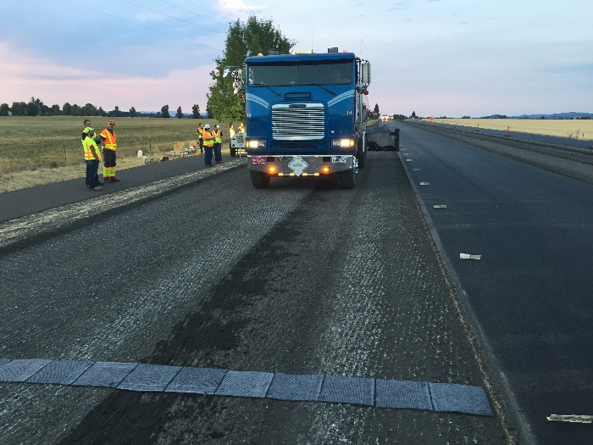
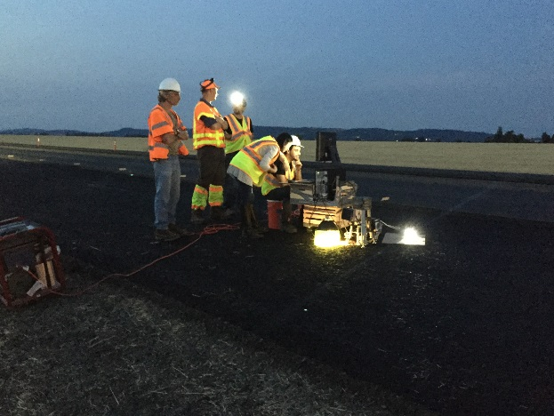
NTBC-41
NTBC-41 is an engineered rejuvenating bonding coat utilized in the paving industry on milled surfaces to achieve excellent bonding, fast curing and minimal tracking characteristics.

Slide 10
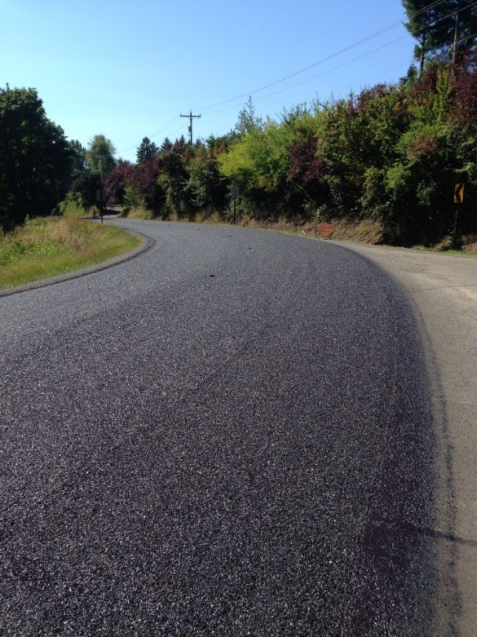
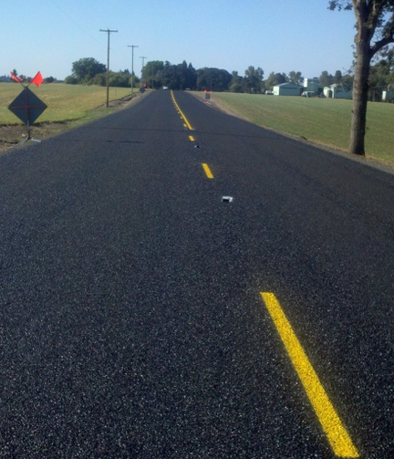
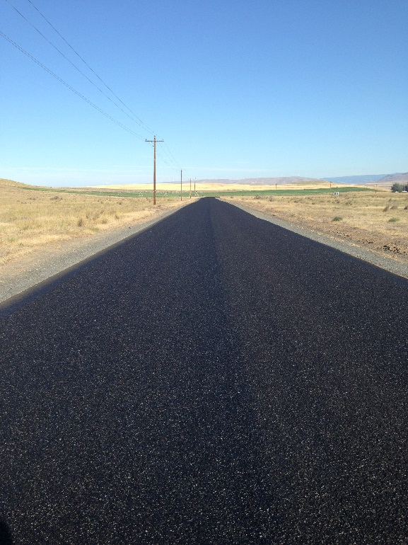
BL-Fog
BL-Fog is an engineered polymer modified fog seal that allows for fast return to traffic and long term performance.

Slide 11
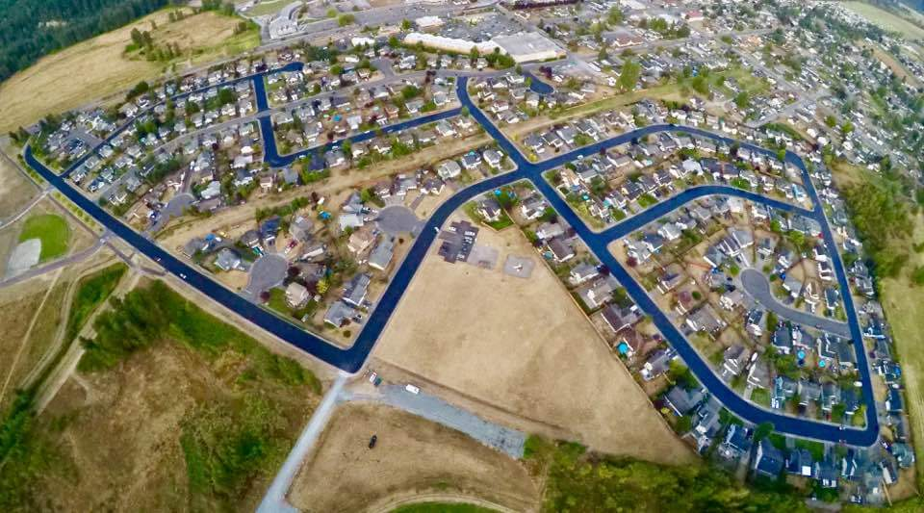
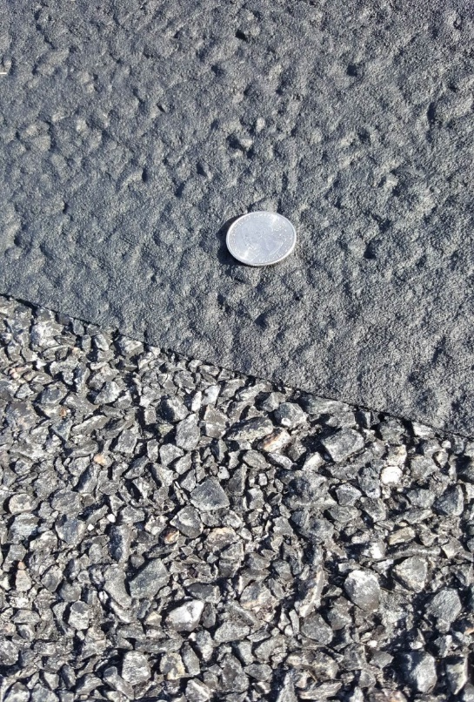
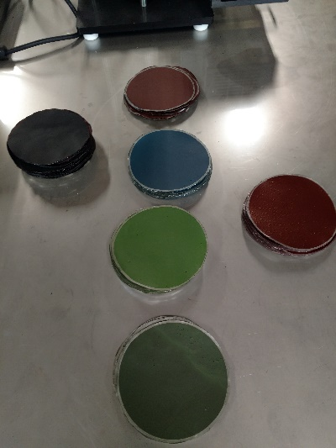
Bl-microcoat
BL-MicroCoat is an engineered polymer modified mineral filled pavement preservation tool that allows for fast return to traffic and long term performance.

Slide 12
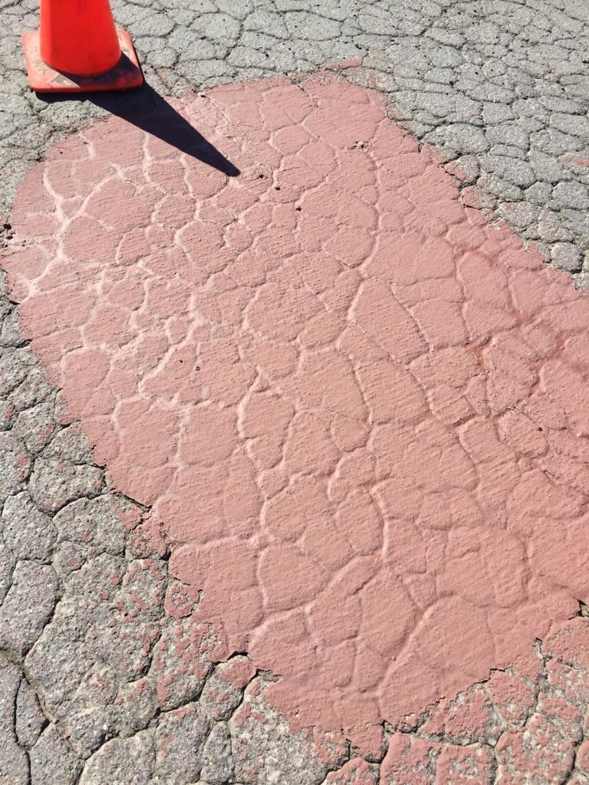
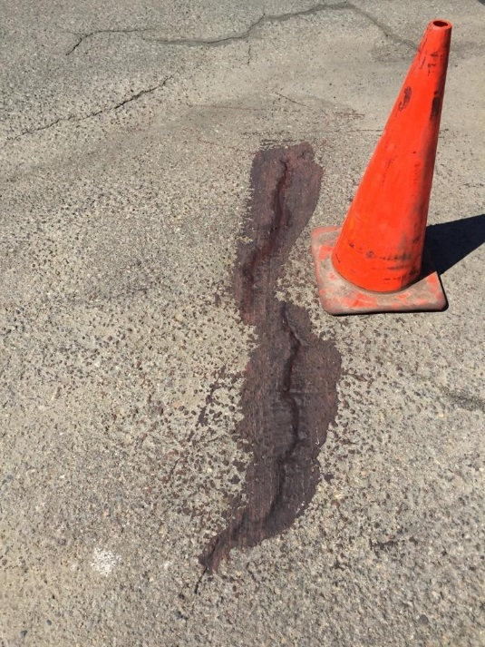
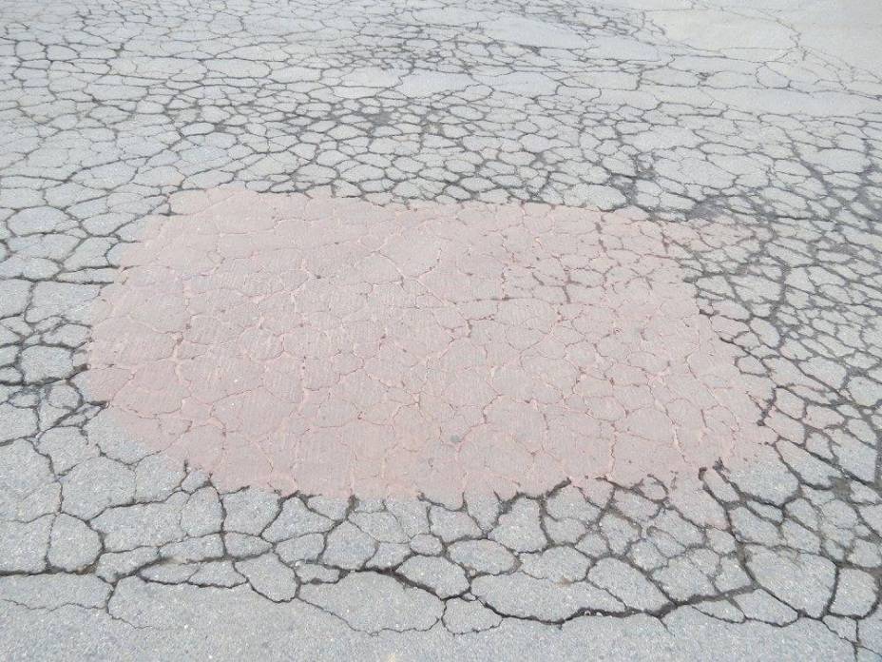
Bl-cs (Crack seal)
BL-CS is an engineered polymer modified emulsion utilized for crack sealing operations.

Slide 13
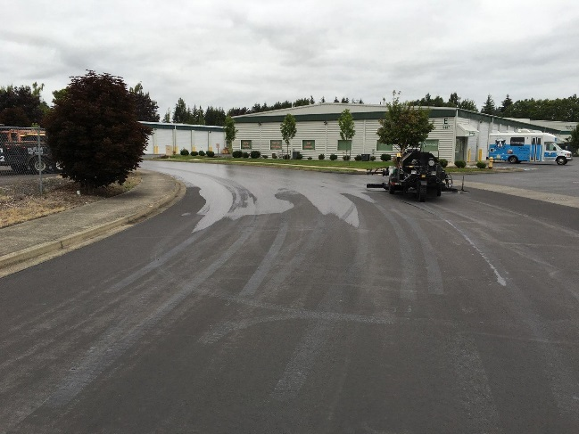
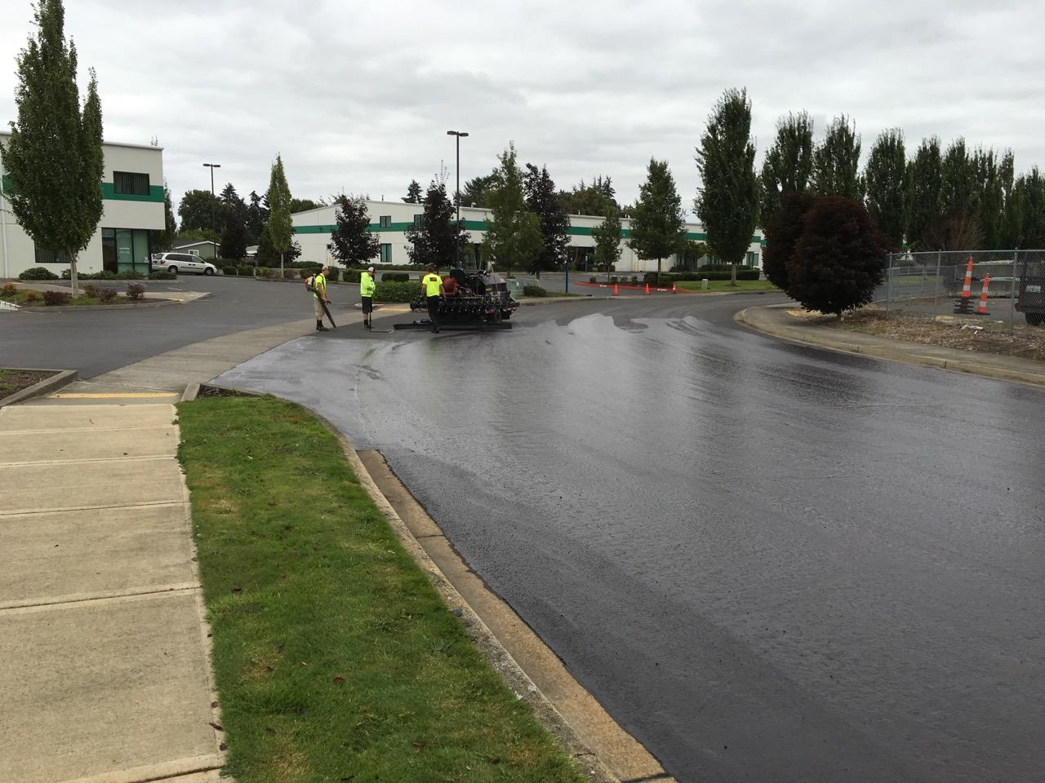
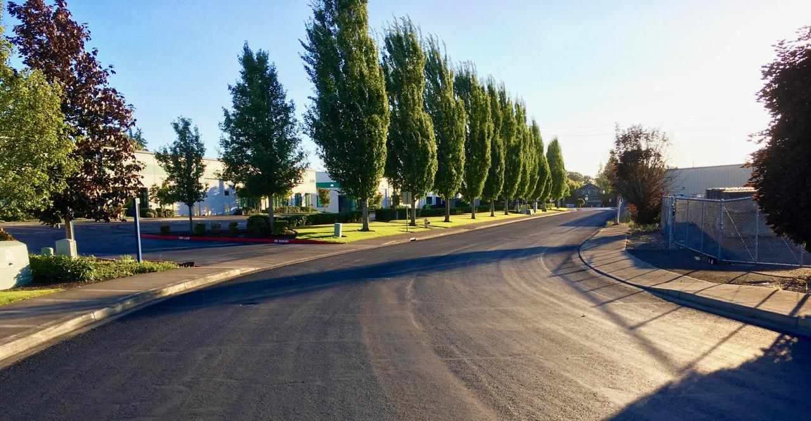
Bl-cs (Crack seal)

Slide 14
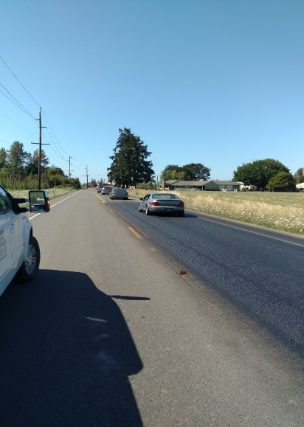
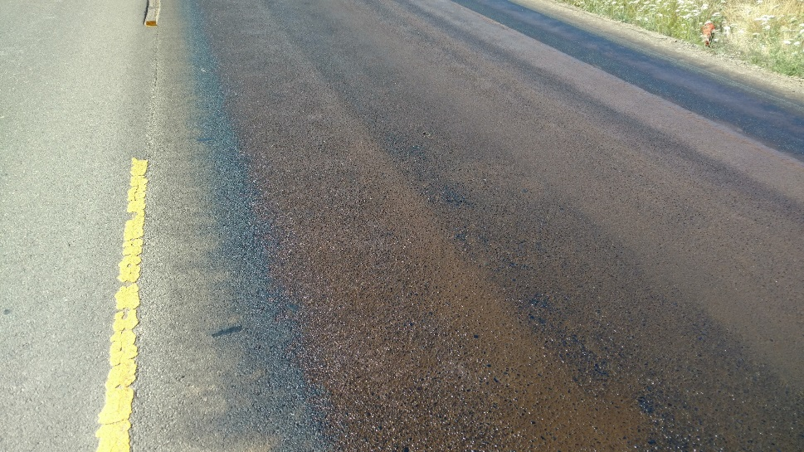
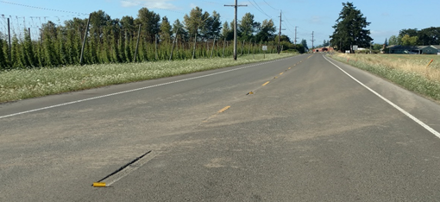
EB-Prime
EB-Prime is an engineered surface prime coat utilized when surface conditions are contaminated with debris that can not be economically removed or when enhanced adhesion is desired.

Slide 15
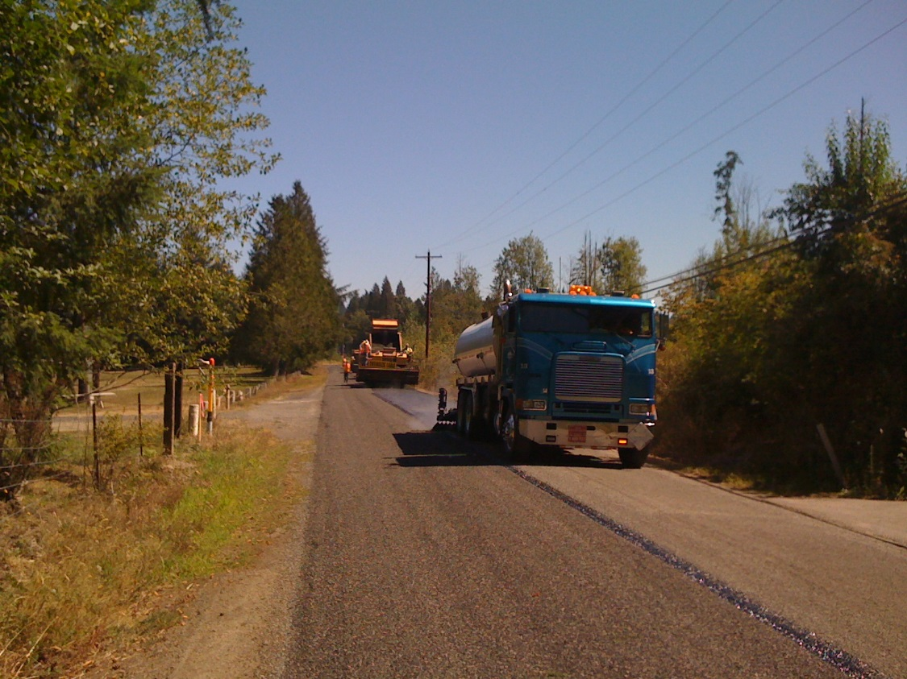
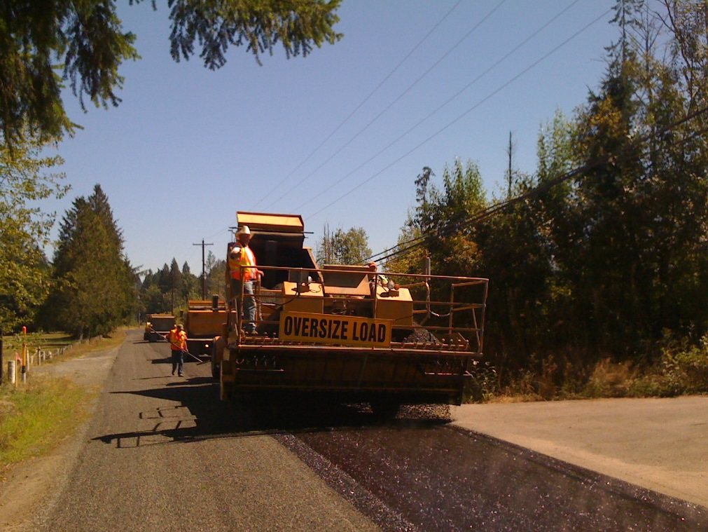
Bl-2p
BL-2P is an engineered polymer modified chip seal emulsion designed for medium volume applications.

Slide 16
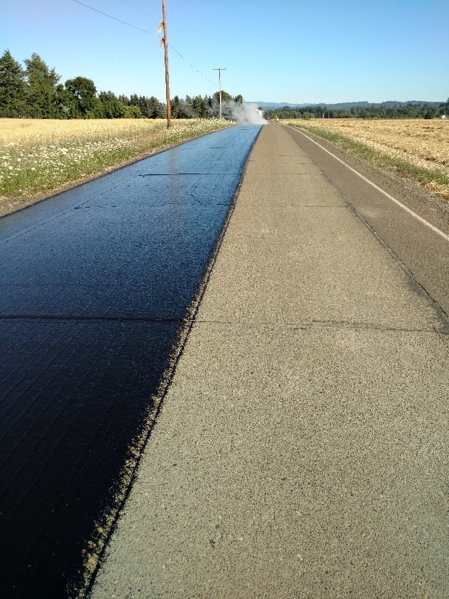
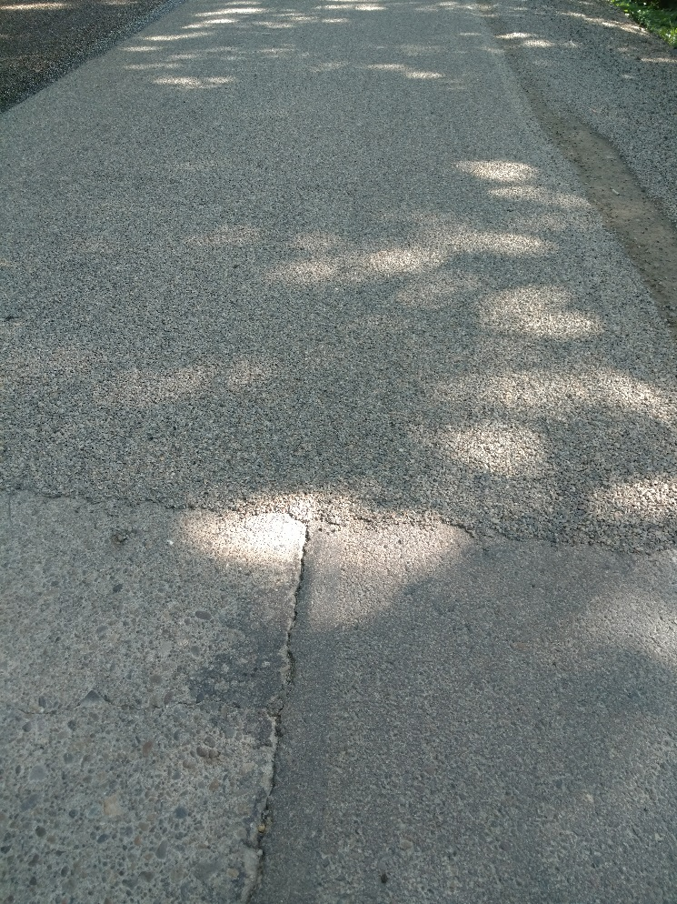
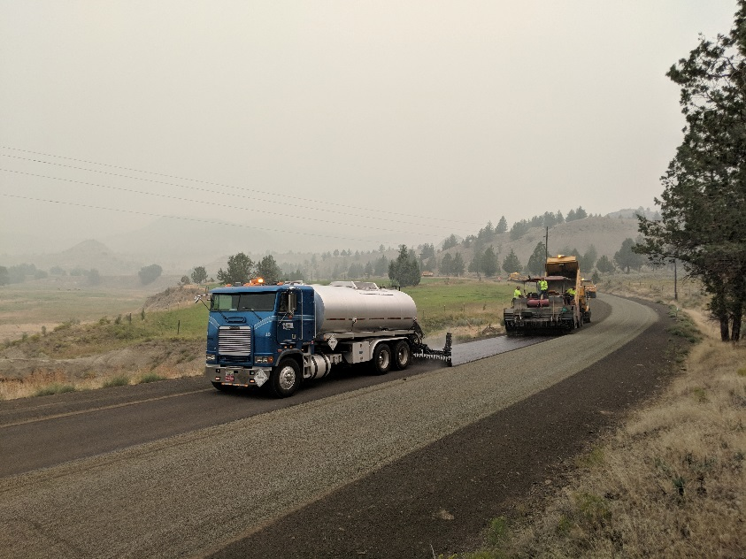
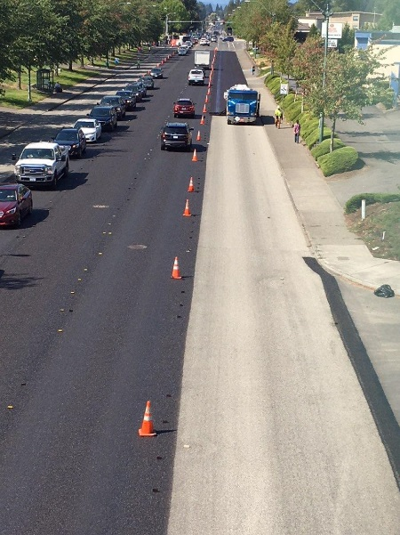
Bl-3p
BL-3P is an engineered polymer modified chip seal emulsion designed for high volume, industrial and city applications.

Slide 17
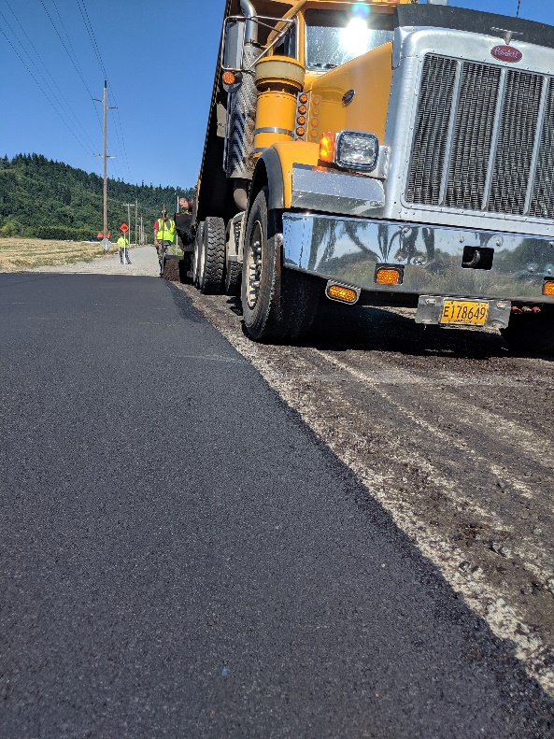
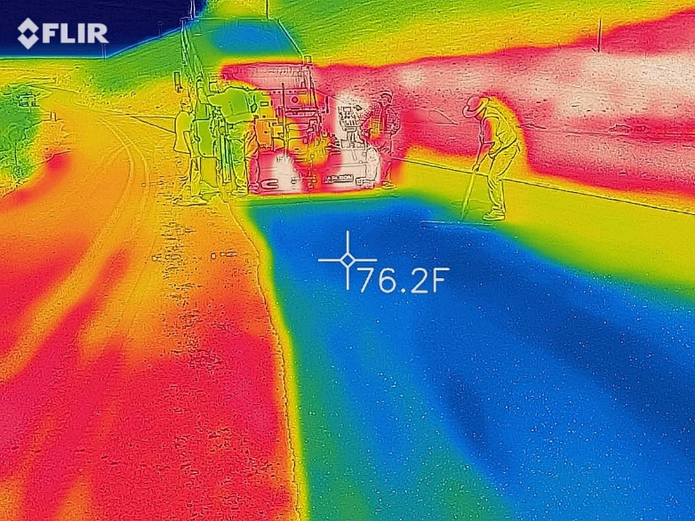
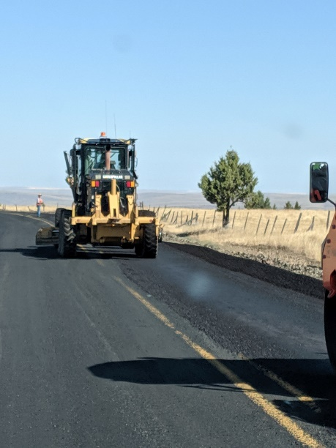
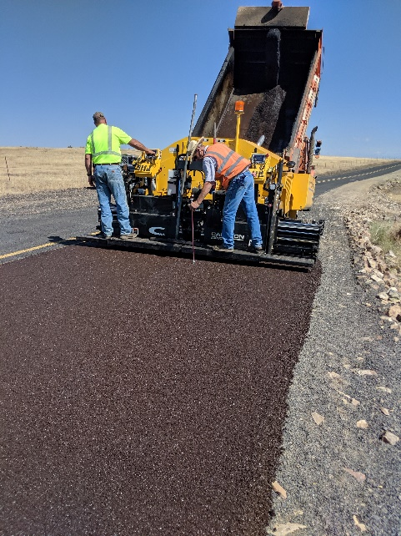
EB-AMA Paving (ambient mix asphalt)
EB-AMA is an engineered asphalt emulsion that is mixed with aggregate at ambient temperature for paving operations.

Slide 18
Thank you
QUESTIONS??

